Slide 1
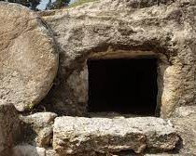
The day of victory John 20:1-31

Slide 2
The terror of the tomb
JOHN 20:1-9

Slide 3
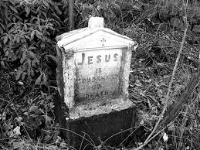
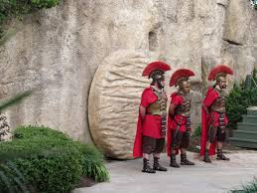
The grave
Helplessness > John 20:1-7
Death

Slide 4
Glimpse of hope John 20:8-9

Slide 5
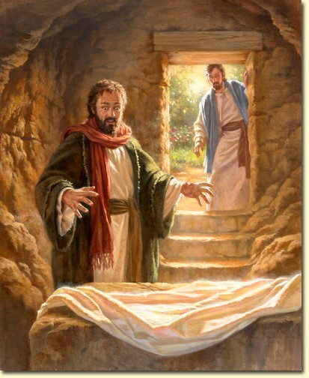

Slide 6
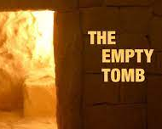
TRIUMPH OVER THE TOMB JOHN 20:10-23

Slide 7
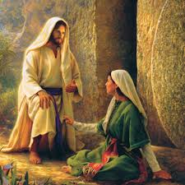

Slide 8
Great Happiness: John 20:16-23

Slide 9
TESTING OF THOMAS JOHN 20:24-31

Slide 10
