Slide 1
Isaiah 53:3-5

Slide 2
I. EXAMPLES IN THE 2020 SUMMER OLYMPICS
Isaiah 53:3-5

Slide 3
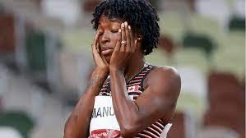
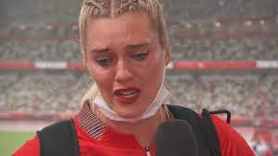
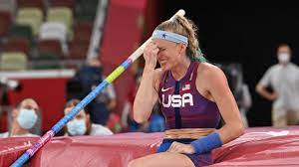
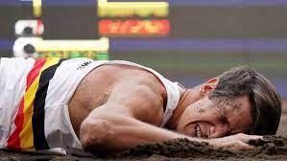
Crystal Emmanuel
Alysha Newman
Sandi Morris
Thomas
Van der Plaeston

Slide 4
II. THE EXAMPLE OF OUR LORD
Isaiah 53:3-5

Slide 5
“The plowers plowed on my back; they made their furrows long”
Psalms 129:3
“When Jesus came out wearing the crown of thorns and the purple robe, Pilate said to them, ‘Here is the man!’”
John 19:5

Slide 6
“For dogs have compassed me: the assembly of the wicked have inclosed me: they pierced my hands and my feet.”
Psalm 22:16
“When Jesus came out wearing the crown of thorns and the purple robe, Pilate said to them, ‘Here is the man!’”
John 19:5

Slide 7
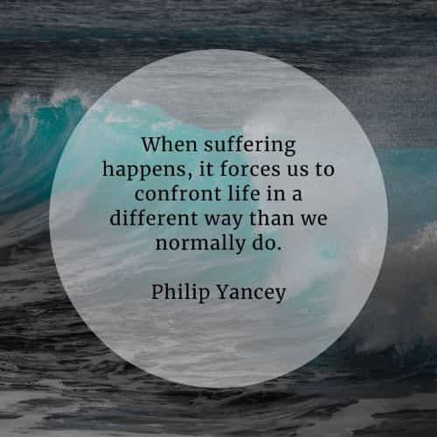

Slide 9
“And I will pour out on the house of David and the inhabitants of Jerusalem a spirit of grace and supplication. They will look on me, the one they have pierced, and they will mourn for him as one mourns for an only child, and grieve bitterly for him as one grieves for a firstborn son.”
Zechariah 12:10

Slide 10
“He was despised and rejected by mankind, a man of suffering, and familiar with pain. Like one from whom people hide their faces he was despised, and we held him in low esteem.
4. Surely he took up our pain and bore our suffering, yet we considered him punished by God, stricken by him, and afflicted.
Isaiah 53:3,4

Slide 11
5. But he was pierced for our transgressions, he was crushed for our iniquities; the punishment that brought us peace was on him, and by his wounds we are healed.”
Isaiah 53:5

Slide 12
“We can rejoice, too, when we run into problems and trials, for we know that they help us develop endurance.”
Romans 5:3, NLTS

