Slide 1
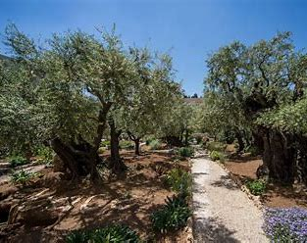
THE GARDEN PLACE
Text: Luke 22:39-46

Slide 2
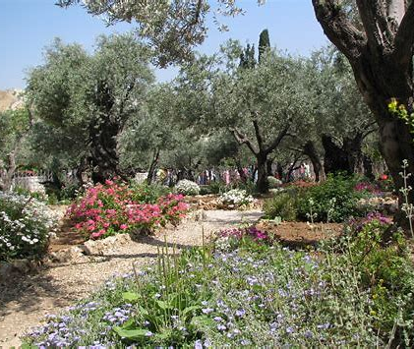
This Garden Grove Represented a Number of Very Important Aspects of Jesus' Life Quite Different than We Look Forward To.

Slide 3
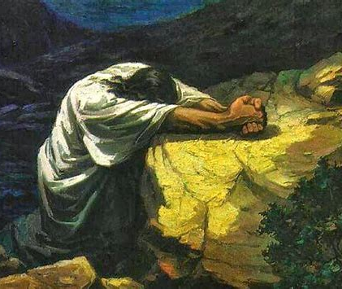

“The heartfelt and persistent prayer of a righteous man (believer) is able to accomplish much [when put into action and made effective by God--it is dynamic and can have tremendous power].”
James 5:16
Amplified Version

Slide 4
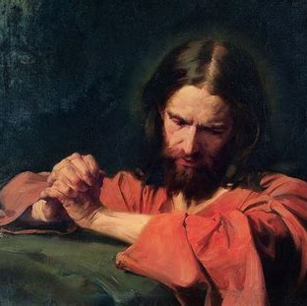
II. IT WAS A PLACE OF MULTIPLE PAIN (Luke 22:44,45)
"For we do not have a high priest who is unable to sympathize with our weaknesses, but we have one who has been tempted in every way, just as we are - yet was without sin."
Hebrews 4:15

Slide 5
II. IT WAS A PLACE OF MULTIPLE PAIN (Luke 22:44,45)
"When he rose from prayer and went back to the disciples, he found them asleep, exhausted from sorrow."
Luke 22:45

Slide 6
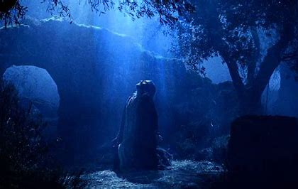
III. IT WAS A PLACE OF INCREASED PERSEVERANCE (Luke 22:42)
"Father, if you are willing, take this cup from me; yet not my will, but yours be done."
Luke 22:42

