Slide 1
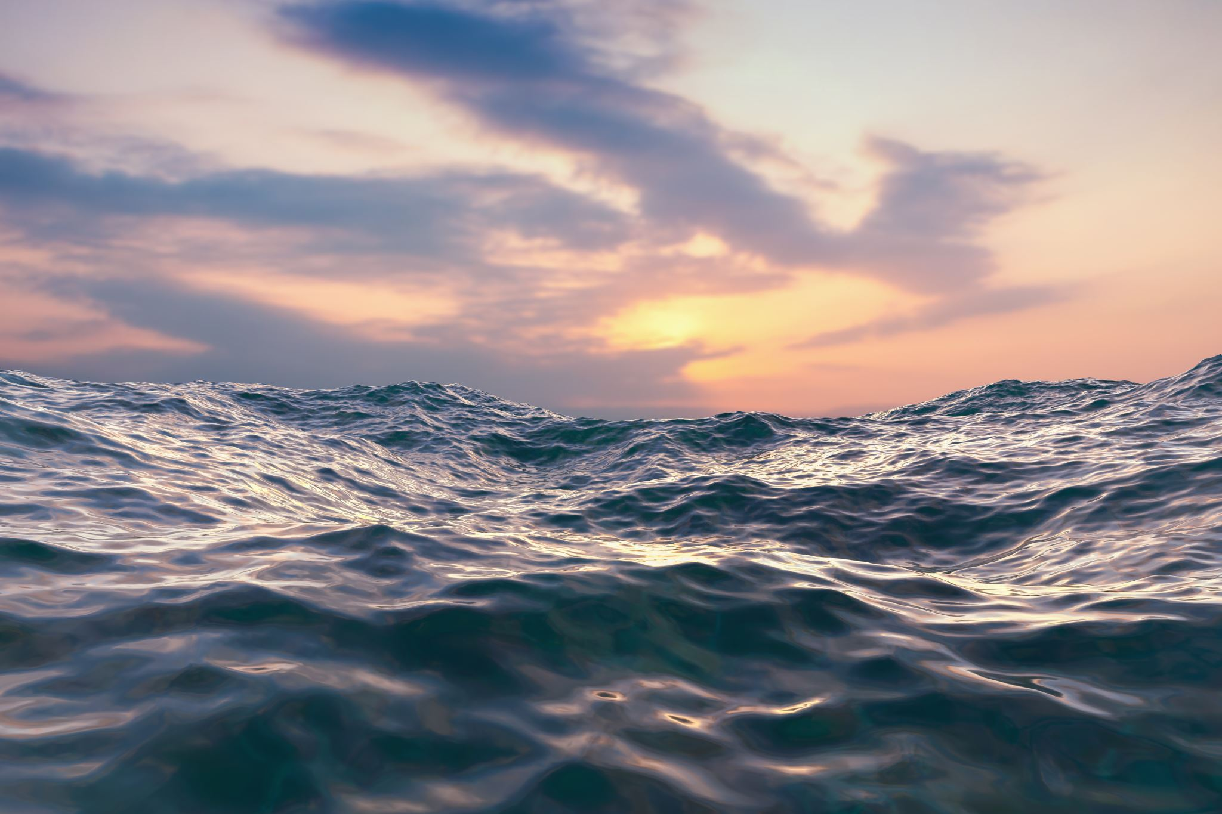
THE LORD OF THE SEA
Text: Matthew 14:22,23

Slide 2
"I tell you the truth, you are looking for me, not because you saw a miraculous sign but because you ate the loaves and had your fill.
27. Do not work for food that spoils, but for food that endures for eternal life, which the Son of Man will give you."
John 6:26,27

Slide 3
I. THE LORD'S COMMAND TO LEAVE THE SHORELINE

Slide 4
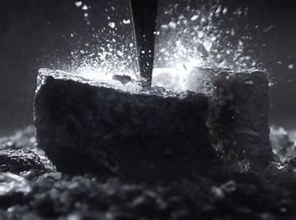
One (Last) Try Did It

Slide 5
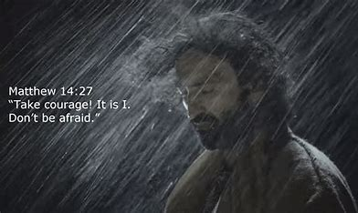

Slide 7
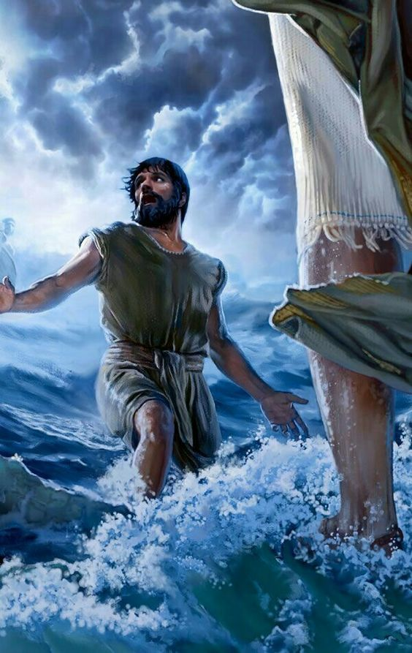
"Lord, If it's you, tell me to come to you on the water."
Matthew 14:28
Without hesitation Jesus said,"Come."
Matthew 14:29

Slide 8
PULLING WITH BOTH OARS

Slide 9
II. TAKING COURAGE TO BELIEVE
"when he saw the wind, he was afraid and, beginning to sink, cried out, Lord, save me!"
Matthew 14:30

Slide 10
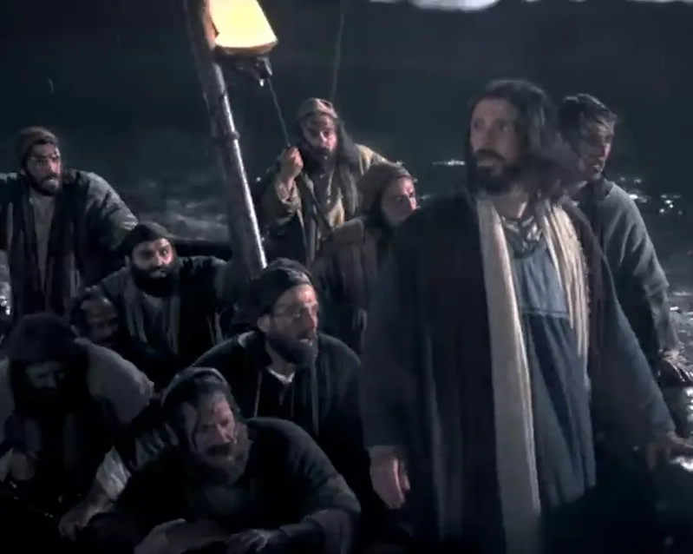
II. TAKING COURAGE TO BELIEVE
"and immediately the boat reached the shore where they were heading."
John 6:21

