Slide 1
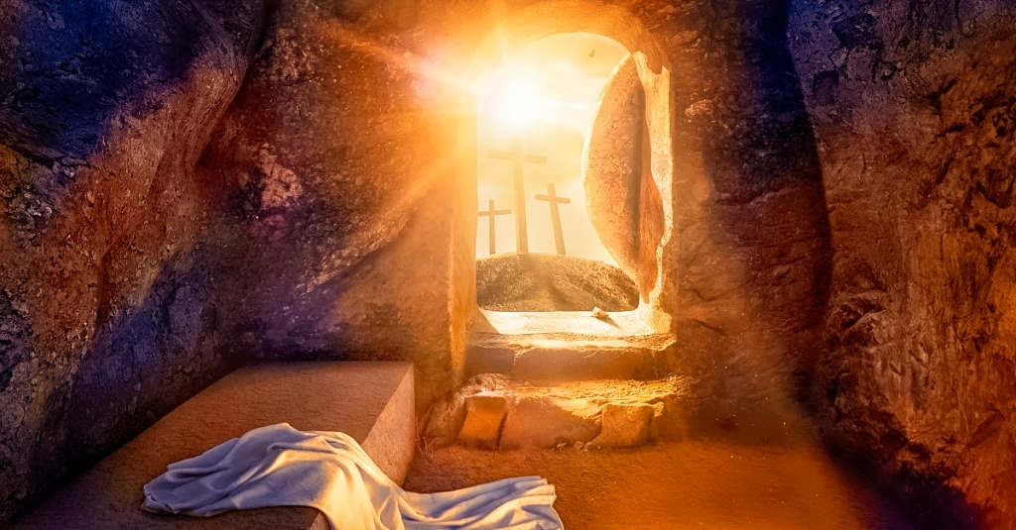
THE MESSAGE
MARK 16:1-8

Slide 2
THE MESSAGE OF THE EASTER ANGEL

Slide 3
I. THE MESSAGE OF PEACE

Slide 4
II. THE MESSAGE OF POWER

Slide 5
III. THE MESSAGE OF POTENTIAL

Slide 6
IV. THE MESSAGE OF PROMISE

Slide 7
THE STORY OF EDITH BURNS

Slide 8
HOW CAN THIS BE? BECAUSE HE LIVES!!

