Slide 1
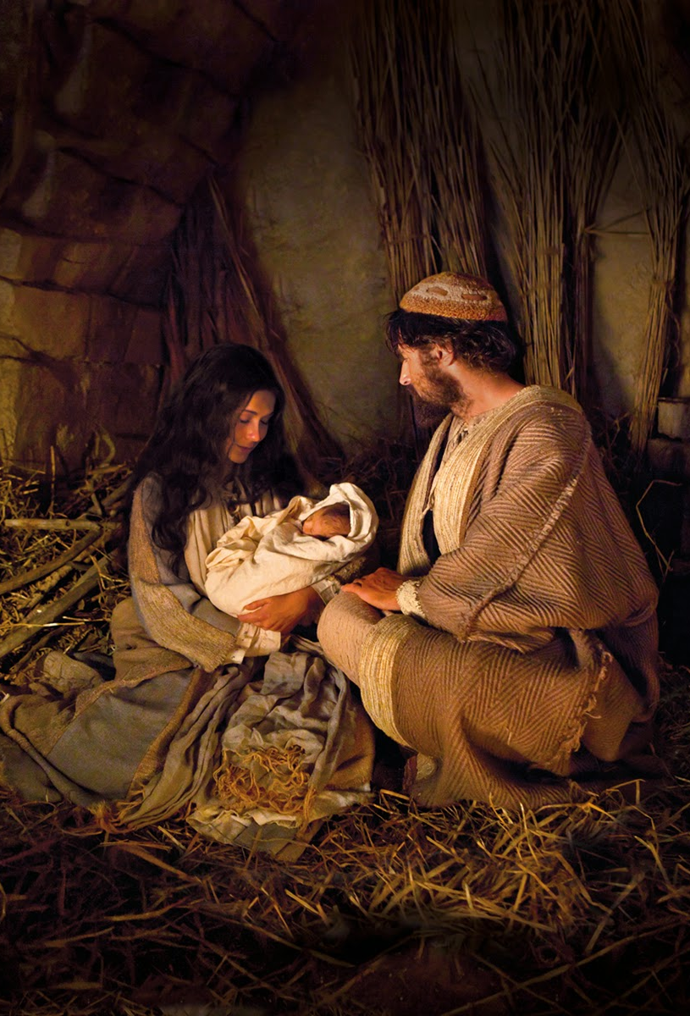
THE MESSIAH IS BORN
Text: Matthew 2:1-23

Slide 2
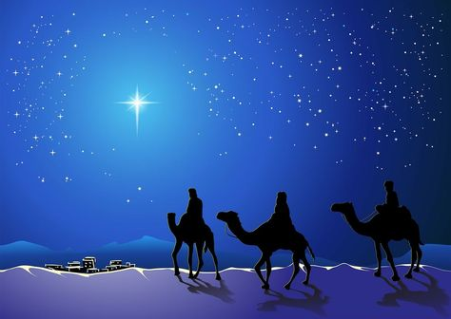
I. THE HOMAGE TO THE KING (Matthew 2:1-12)

Slide 3
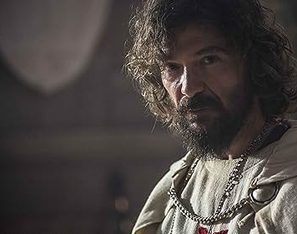
I. THE HOMAGE TO THE KING (Matthew 2:1-12)
Daniel 5:11- was probably rab-mag—
chief of the Magi.

Slide 4
I. THE HOMAGE TO THE KING (Matthew 2:1-12)
the Magi appear as “wise men”—
properly Magians

Slide 5
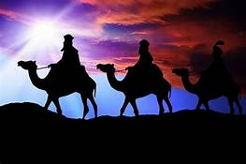
I. THE HOMAGE TO THE KING (Matthew 2:1-12)
they were Gentiles
they were scholars
they were men of the east

Slide 6
I. THE HOMAGE TO THE KING (Matthew 2:1-12)
“a star should come out of Jacob, pointing at a sceptre, that shall rise out of Israel;”
see Numbers 24:17

Slide 7
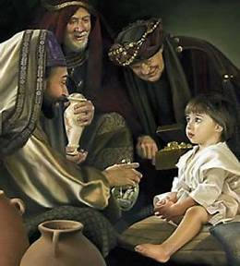
I. THE HOMAGE TO THE KING (Matthew 2:1-12)
Those who truly desire to know Christ, and find him, will not regard pains or perils in seeking after him

Slide 8
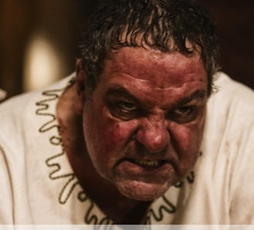
II. THE HOSTILITY AGAINST THE KING (Matthew 2:13-18)
Herod quickly became antagonistic against the Christ-child

Slide 9
II. THE HOSTILITY AGAINST THE KING (Matthew 2:13-18)
This is what the Lord says:
“A voice is heard in Ramah, mourning and great weeping, Rachel weeping for her children and refusing to be comforted, because they are no more.” Jeremiah 31:15

Slide 10
II. THE HOSTILITY AGAINST THE KING (Matthew 2:13-18)
Jacob saw Bethlehem as a place of death for Rachel, while the birth of Jesus made it a place of life.

Slide 11
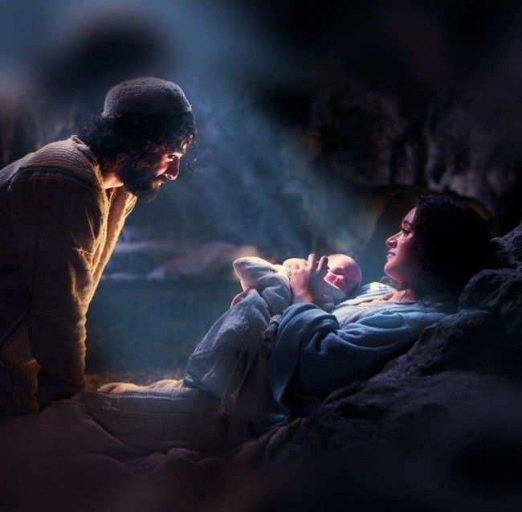
III. THE HUMILITY OF THE KING (Matthew 2:19-23)
Sometimes it just takes one single act to change an entire world.

Slide 12
III. THE HUMILITY OF THE KING (Matthew 2:19-23)
Last Christmas
. . .
this Christmas

Slide 13
III. THE HUMILITY OF THE KING (Matthew 2:19-23)
The remarkable thing about it is that He did it with such humility that the world has never seen it duplicated since.

