Slide 1
THE NEW SONG
Text: Revelation 5:9

Slide 2
I. THE HIGHEST NOTE
“You are worthy . . . “
Revelation 5:9a

Slide 3
I. THE HIGHEST NOTE
“The revelation from (of) Jesus Christ, which God gave him to show his servants what must soon take place. He made it known by sending his angel to his servant John”
Revelation 1:1

Slide 4
I. THE HIGHEST NOTE
“After this I looked, and there before me was a door standing open in heaven. And the voice I had first heard speaking to me like a trumpet said, "Come up here, and I will show you what must take place after this.“
Revelation 4:1

Slide 5
I. THE HIGHEST NOTE
“Immediately I was in the Spirit; and behold, a throne was standing in heaven, and One sitting on the throne.
3. And He who was sitting was like a jasper stone and a sardius in appearance; and there was a rainbow around the throne, like an emerald in appearance.”
Revelation 4:2,3

Slide 6
I. THE HIGHEST NOTE
“Each of the four living creatures had six wings and was covered with eyes all around, even under its wings. Day and night they never stop saying: ‘Holy, holy, holy is the Lord God Almighty, who was, and is, and is to come . . .
8. You are worthy, our Lord and God, to receive glory and honor and power, for you created all things, and by your will they were created and have their being.”
Revelation 4:8,11

Slide 7
I. THE HIGHEST NOTE
“Then one of the elders said to me, “Do not weep! See, the Lion of the tribe of Judah, the Root of David, has triumphed. He is able to open the scroll and its seven seals.”
6. Then I saw a Lamb, looking as if it had been slain, standing at the center of the throne, encircled by the four living creatures and the elders. The Lamb had seven horns and seven eyes, which are the seven spirits of God sent out into all the earth.” Revelation 5:5,6

Slide 8
I. THE HIGHEST NOTE
“And they sang a new song, saying: “You are worthy to take the scroll and to open its seals, because you were slain, and with your blood you purchased for God persons from every tribe and language and people and nation.
“In a loud voice they were saying: “Worthy is the Lamb, who was slain, to receive power and wealth and wisdom and strength and honor and glory and praise!”
Revelation 5:9,12

Slide 9
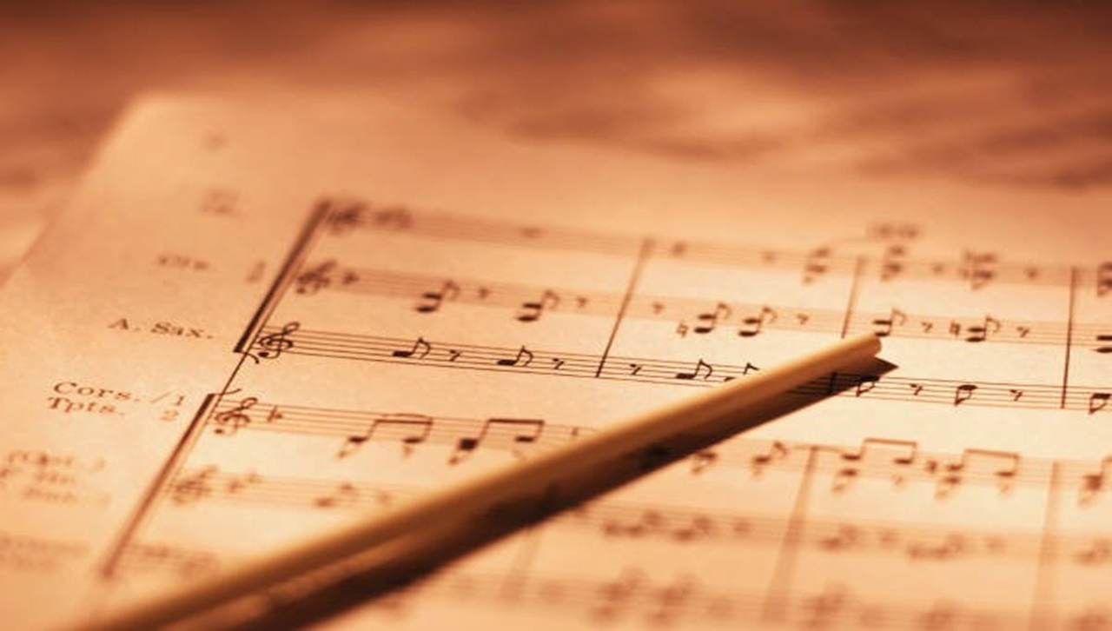
II. THE SWEETEST THEME
“Because you were slain, and with your blood you purchased men for God . . .”
Revelation 5:9b

Slide 10
II. THE SWEETEST THEME
“Now the earth was corrupt in God’s sight and was full of violence.
¹² God saw how corrupt the earth had become, for all the people on earth had corrupted their ways.
¹³ So God said to Noah, “I am going to put an end to all people, for the earth is filled with violence because of them. I am surely going to destroy both them and the earth.
Genesis 6:11-13

Slide 11
II. THE SWEETEST THEME
“Then a mighty angel picked up a boulder the size of a large millstone and threw it into the sea, and said:
“With such violence the great city of Babylon will be thrown down, never to be found again.”
Revelation 18:21

Slide 12
II. THE SWEETEST THEME
“ you were bought with a price . . .”
I Corinthians 6:20

Slide 13
II. THE SWEETEST THEME
“For all have sinned and fall short of the glory of God,
24. And are justified freely by his grace through the redemption that came by Christ Jesus.
25 God presented him as a sacrifice of atonement [as the one who would turn aside his wrath - the propitiation], through faith in his blood.”
Romans 3:23-25

Slide 14
III. THE WIDEST RESULT
“For all have sinned and fall short of the glory of God,
24. And are justified freely by his grace through the redemption that came by Christ Jesus.
25 God presented him as a sacrifice of atonement [as the one who would turn aside his wrath - the propitiation], through faith in his blood.”
Romans 3:23-25

Slide 15
III. THE WIDEST RESULT
“. . . from every tribe and language and people and nation.”
Revelation 5:9c

