Slide 1
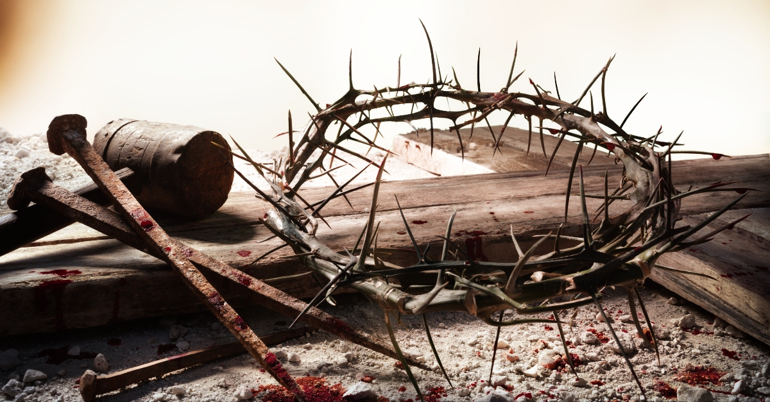
THE OFFENCE OF THE CROSS
Text: I Corinthians 1:18,19,23

Slide 2
I. HOW COULD A LOVING HEAVENLY FATHER ALLOW IT?
“When the sentence for a crime is not quickly carried out, people’s hearts are filled with schemes to do wrong.
12. Although a wicked person who commits a hundred crimes may live a long time, I know that it will go better with those who fear God, who are reverent before him.
13. Yet because the wicked do not fear God, it will not go well with them”
Ecclesiastes 8:11-13

Slide 3
I. HOW COULD A LOVING HEAVENLY FATHER ALLOW IT?
“For God so loved the world that he gave his one and only Son, that whoever believes in him shall not perish but have eternal life.”
John 3:16

Slide 4
I. HOW COULD A LOVING HEAVENLY FATHER ALLOW IT?
“It is for freedom that Christ has set us free. Stand firm, then, and do not let yourselves be burdened again by a yoke of slavery . . .
6. The only thing that counts is faith expressing itself through love.”
Galatians 5:1,6

Slide 5
I. HOW COULD A LOVING HEAVENLY FATHER ALLOW IT?
“The wages of sin is death, but the gift of God is eternal life through Jesus Christ our Lord.”
Romans 3:23

Slide 6
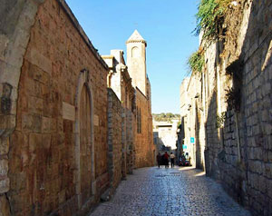
II. HOW COULD A NATION ENDORSE IT?
“Then Jesus said to his disciples, “Whoever wants to be my disciple must deny themselves and take up their cross and follow me. 25. For whoever wants to save their life will lose it, but whoever loses their life for me will find it.”
Matthew 16:24,25

Slide 7
II. HOW COULD A NATION ENDORSE IT?
“I have been crucified with Christ and I no longer live, but Christ lives in me. The life I now live in the body, I live by faith in the Son of God, who loved me and gave himself for me.”
Galatians 2:20

Slide 8
II. HOW COULD A NATION ENDORSE IT?
“While Pilate was sitting on the judge’s seat, his wife sent him this message: “Don’t have anything to do with that innocent man, for I have suffered a great deal today in a dream because of him.”
20. But the chief priests and the elders persuaded the crowd to ask for Barabbas and to have Jesus executed.

Slide 9
II. HOW COULD A NATION ENDORSE IT?
21. “Which of the two do you want me to release to you?” asked the governor. “Barabbas,” they answered.
22 “What shall I do, then, with Jesus who is called the Messiah?” Pilate asked. They all answered, “Crucify him!”

Slide 10
II. HOW COULD A NATION ENDORSE IT?
23. “Why? What crime has he committed?” asked Pilate. But they shouted all the louder, “Crucify him!”
Matthew 27:19-23

Slide 11
II. HOW COULD A NATION ENDORSE IT?
“If the world hates you, keep in mind that it hated me first.
19. If you belonged to the world, it would love you as its own. As it is, you do not belong to the world, but I have chosen you out of the world. That is why the world hates you.”
John 15:18,19

Slide 12
III. HOW COULD IT BRING ABOUT SUCH WIDESPREAD DELIVERANCE?
“For the message of the cross is foolishness to those who are perishing, but to us who are being saved it is the power of God.
19. For it is written: “I will destroy the wisdom of the wise; the intelligence of the intelligent I will frustrate . . .
25. For the foolishness of God is wiser than human wisdom, and the weakness of God is stronger than human strength.”
I Corinthians 1:18,19,25

Slide 13
III. HOW COULD IT BRING ABOUT SUCH WIDESPREAD DELIVERANCE?
“When you were dead in your sins and in the uncircumcision of your flesh, God made you alive with Christ. He forgave us all our sins,
14. having canceled the charge of our legal indebtedness, which stood against us and condemned us; he has taken it away, nailing it to the cross.
15. And having disarmed the powers and authorities, he made a public spectacle of them, triumphing over them by the cross.”
Colossians 2:13-15

Slide 14
III. HOW COULD IT BRING ABOUT SUCH WIDESPREAD DELIVERANCE?
Deliverance in itself
is not freedom,
It is the opportunity
to pursue freedom.
What we do with what God has freely given to us is our choice.
Make good use of the opportunity.

