Slide 1
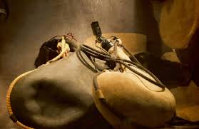
THE PARABLE OF THE NEW WINE AND OLD WINESKINS
Text: Matthew 9:14-17
Mark 2:18-22; Luke 5:33-39

Slide 2
THE PARABLE OF THE NEW WINE AND OLD WINESKINS
“Like old wineskins, the Pharisees and indeed the entire religious system of Judaism had become too rigid to accept Jesus. They could not contain him or his message in their traditions or rules. Their understanding of faithfulness to the law had become unsuitable for the fresh, dynamic power of Christ’s message.“
Life Application Concise New Testament Commentary

Slide 3
I.I. THE METHOD WAS DIFFERENT
“For whoever keeps the whole law and yet stumbles at just point is guilty of breaking all of it.”
James 2:10

Slide 4
I.I. THE METHOD WAS DIFFERENT
“Forget the former things; do not dwell on the past.
19. See I am doing a new thing! Now it springs up; do you not perceive it? I am making a way in the desert and streams in the wasteland.”
Isaiah 43:18,19

Slide 5
II. THE TASTE WAS DIFFERENT
“And no one after drinking the old wine wants the new, for he says, ‘The old is better.’”
Luke 5:39

Slide 6
II. THE TASTE WAS DIFFERENT
“And no one after drinking the old wine wants the new, for he says, ‘The old is better.’”
Luke 5:39

