Slide 1
THE PARABLE OF THE SHEEP AND GOATS
Text: Matthew 25:31-46

Slide 2
1. The Judgement Seat of Christ
“For we must all appear before the judgement seat of Christ, that each one may receive what is due him for the things done while in the body, whether good or bad.”
II Corinthians 5:10

Slide 3
1. The Judgement Seat of Christ
“If any man builds on this foundation [Jesus Christ - see verse 11] using gold, silver, costly stones, wood hay or straw,
13. His work will be shown for what it is, because the Day will bring it to light. It will be revealed with fire, and the fire will test the quality of each man’s work.
I Corinthians 3:12-13

Slide 4
1. The Judgement Seat of Christ
14. If what he has built survives, he will receive his reward.
15. If it is burned up, he will suffer loss; he himself will be saved, but only as one escaping through the flames.”
I Corinthians 3:14-15

Slide 5
2. The Judgement of the Living Nations
“Do not be deceived: God cannot be mocked. A man reaps what he sows.
8. The one who sows to please his sinful nature, from that nature will reap destruction; the one who sows to please the Spirit, from the Spirit will reap eternal life.”
Galatians 6:7,8

Slide 6
3. The Great White Throne Judgement
“And I saw the dead, great and small, standing before the throne, and the books were opened. Another book was opened, which is the book of life. The dead were judged according to what they had done as recorded in the books.”
Revelation 20:12

Slide 7
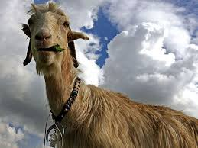
I. The Goats (Matthew 25:41-36)

Slide 8
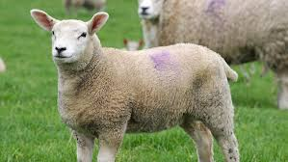
II. The Sheep (Matthew 25: 31-40)

Slide 9
II. The Sheep (Matthew 25: 31-40)
“The King will reply, ‘I tell you the truth, whatever you did for one of the least of these brothers of mine, you did for me.”
Matthew 25:40

