Slide 1
THE PARABLES OF THE KINGDOM – X The Parable of the Vineyard
Text: Matthew 21:33-46

Slide 2
"By what authority are you doing these things?" they asked. "And who gave you this authority."
Matthew 21:23

Slide 3
"What do you think?. . ."
Matthew 21:28

Slide 4
II. THE PARABLE OF THE VINEYARD
This parable is recorded only in the Synoptic Gospels
Mark 12:1-12; Luke 20:9-19

Slide 5
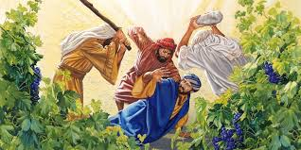
II. THE PARABLE OF THE VINEYARD
A. The Landowner

Slide 6
II. THE PARABLE OF THE VINEYARD
B. Vineyard
"My loved one had a vineyard on a fertile hillside.
2. He dug it up and cleared it of stones and planted it with choicest vines. He built a watchtower in it and cut out a winepress as well. Then he looked for a crop of good grapes, but it yielded only bad fruit . . .
7. The vineyard of the LORD Almighty is the house of Israel."
Isaiah 5:1,2,7

Slide 7
II. THE PARABLE OF THE VINEYARD
C. The Wall (Hedge)
D. The Tower
E. The Winepress
F. The Farmers (husbandmen)
G. The Servants

Slide 8
II. THE PARABLE OF THE VINEYARD
H. The Son (Heir)
"This man was handed over to you by God’s
set purpose and foreknowledge; and you, with the help of wicked men, put him to death by nailing him to the cross."
Acts 2:23

Slide 9
II. THE PARABLE OF THE VINEYARD
I. The Sentence
God used the Roman armies to tear the vineyard from the husbandmen. He gave it to the Church. It is now OUR responsibility

