Slide 1
THE REDEEMER
Titus 2:11-14

Slide 2
Why do we need a Redeemer?

Slide 3
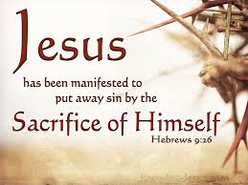
A. The Sacrifice of Christ Hebrews 9:26; Hebrews 10:8-12

Slide 4
B. Redemption- Reclaim by Payment
A. By Grace
Ephesians 2:8

Slide 5
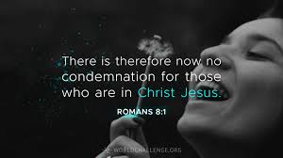
B. Redemption- Reclaim by Payment
B. We are redeemed from Condemnation - Romans 8:1

Slide 6
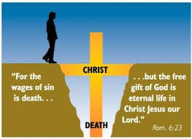
B. Redemption- Reclaim by Payment
C. Guilt &
The Power of Sin
Hebrews 8:12; 10-17

Slide 7
B. Redemption- Reclaim by Payment
D. We are redeemed to
live a joyful life with Christ
John 15:11

Slide 8
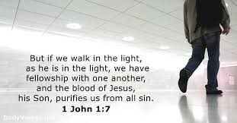
C. Cleansing
The Promise of Cleansing –
1 John 1:7; Isaiah 1:18

Slide 9
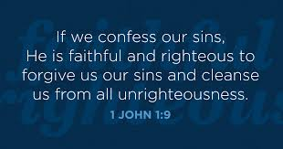
C. Cleansing
B. The Purpose of Cleansing

Slide 10
C. Cleansing
C. To Present Yourself For Service

Slide 11
The greatest gift ever given… to be Redeemed !!!!!

