Slide 1
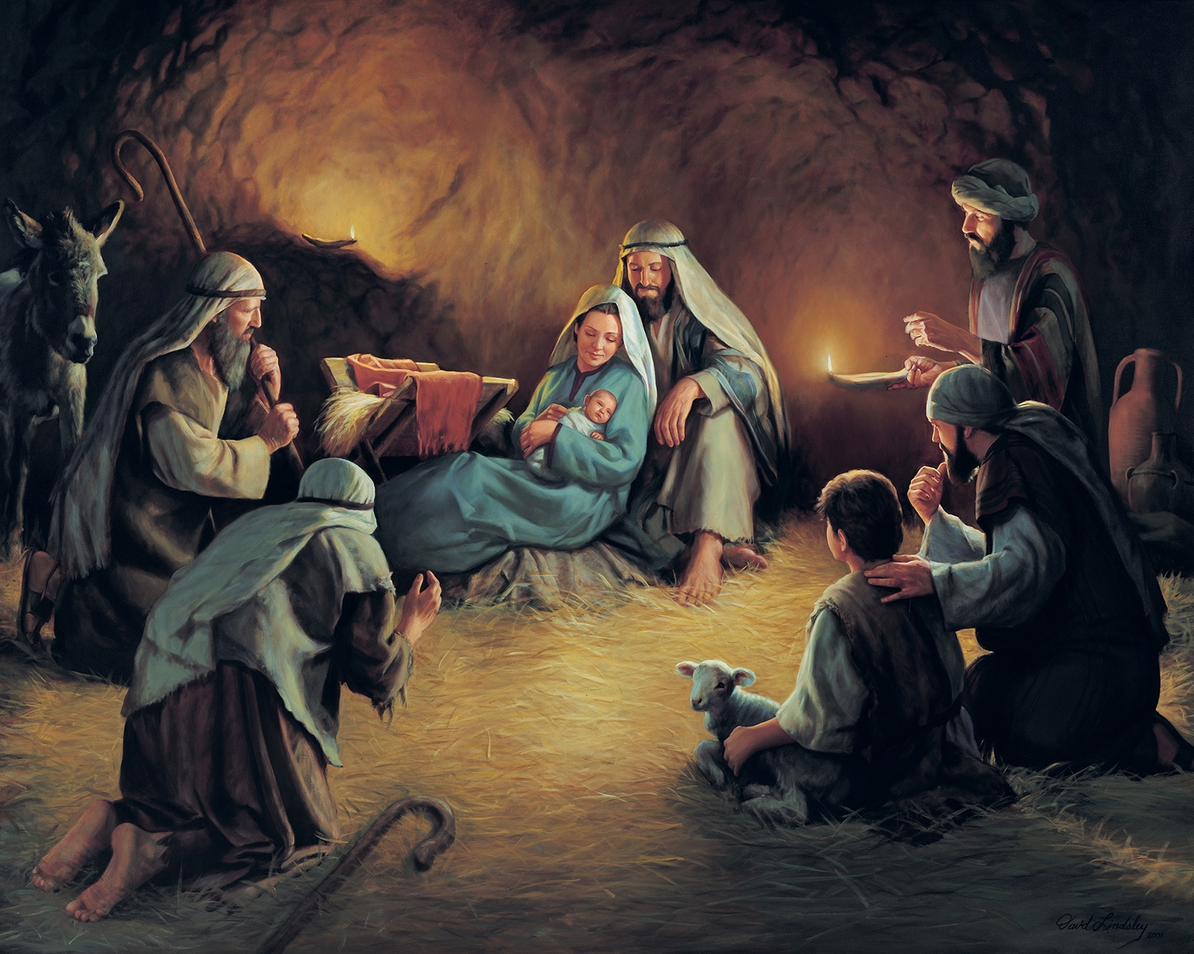
THE REVELATION OF JESUS CHRIST
Text: Luke 2:8-11

Slide 2
“And there were shepherds living out in the fields nearby, keeping watch over their flocks at night. 9. An angel of the Lord appeared to them, and the glory of the Lord shone around them, and they were terrified. 10. But the angel said to them, ‘Do not be afraid. I bring you good news of great joy that will be for all people. 11. Today in the town of David a Savior has been born to you; he is Christ the Lord.” Luke 2:8-11

Slide 3
There are specific methods He has adopted for the Proclamation of His Revelation. I. Revealed Man to himself

Slide 4
∙Moses received his credentials to lead his people while caring for Jethro’s sheep ∙Gideon was threshing wheat by the winepress when he received his commission ∙Saul was seeking out his father’s lost donkeys when he was chosen to be king ∙Samuel waited to anoint David while they summoned him from “those few sheep in the wilderness” ∙Elisha was ploughing when Elijah passed by and cast the mantle of prophecy upon him ∙

Slide 5
∙Amos as a herdsman of Tekoa was called to prophesy judgment against Philistia and Tyre ∙Zacharias was executing his priestly duty while Gabriel announced the message of “joy and gladness.” ∙The shepherds while “abiding . . . and keeping watch” were chosen to receive “good tidings.” ∙Peter, James and John left their nets to become “fishers of men.” ∙Levi was collecting taxes when Jesus called out for him to follow

Slide 6
II. Revealed Himself to Man
“For unto you is born this day in the city of David a Savior, which is Christ the Lord.”
Luke 2:11 KJV

Slide 7
II. Revealed Himself to Man
Jacob’s loss of his son Joseph, prepared the way for an abundance provision during a time of great famine
∙ The Red Sea opened at a time of hopelessness to proclaim the majesty of God
∙ The conquest into the promised land was immediately met with the walls of Jericho which were forced to bow in humility
∙ Saul being unhorsed and blinded released an inner light that shone into the nations
∙ The exile of the beloved John, offered an opportune time for God to unfold His apocalyptic Revelation

Slide 8
III. Revealed Himself through Man
“. . . which shall be to all people . . .”
Luke 2:10 KJV

Slide 9
III. Revealed Himself through Man
“And how can they preach unless they are sent? As it is written, ‘How beautiful are the feet of those who bring good news!”
Romans 10:15

Slide 10
III. Revealed Himself through Man
“When they had seen him [after he had revealed himself to them], they spread the word concerning what had been told them about this child,” Luke 2:17

Slide 11
III. Revealed Himself through Man
“ . . . that will be for all people . . .”
Luke 2:10b

Slide 12
III. Revealed Himself through Man
“When they had seen him, they spread the word concerning what had been told them about this child . . .
20. The shepherds returned, glorifying and praising God for all the things they had heard and seen, which were just as they had been told.” Luke 2:17,20

