Slide 1
THE ARMOUR OF GOD - PART IV The Shield of Faith
Text: Ephesians 6:16

Slide 2
“In addition to all this, take up the shield of faith, with which you can extinguish all the flaming arrows of the evil one." Ephesians 6:16

Slide 3
What Are Five Noticeable Things That Paul Describes?

Slide 4
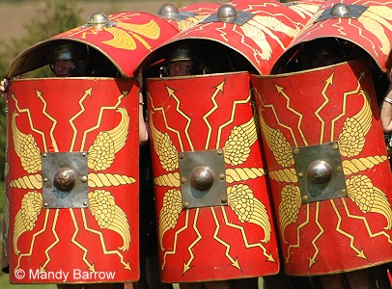
I. THE ROMAN SHIELD

Slide 5
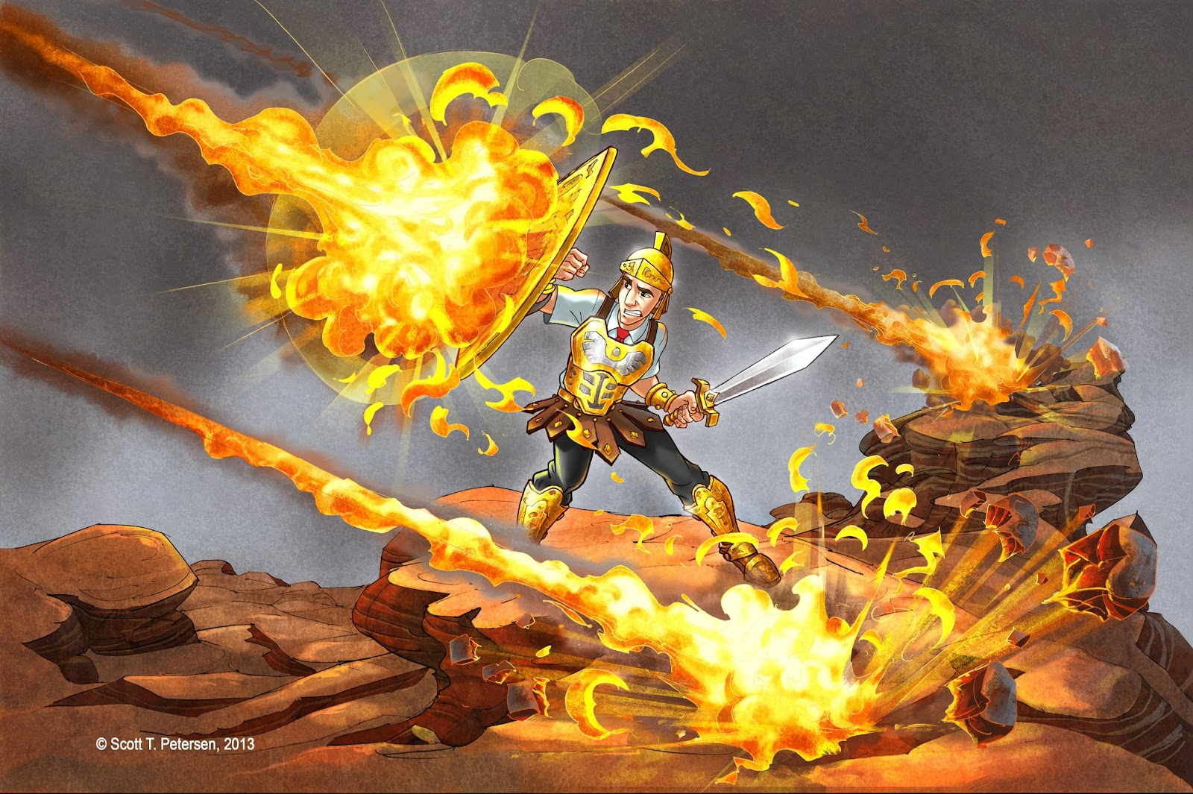
II. THE FIERY DARTS

Slide 6
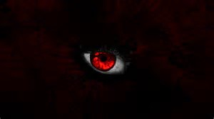
III. THE ENEMY

Slide 7
IV. THE TACTIC
"No temptation has seized you except what is common to man. And God is faithful; he will not let you be tempted beyond what you are able to bear. But when you are tempted, he will provide a way out so you can stand up under it."
I Corinthians 10:13

Slide 8
IV. THE TACTIC
"Dear friends, do not be surprised at the painful (fiery - KJV) trial you are suffering, as though something strange were happening to you."
I Peter 4:12

Slide 9
V. OUR DEFENCE
"for everyone born of God overcomes the world. This is the victory that overcomes the world, even our faith.
5. Who is it that overcomes the world? Only he who believes that Jesus is the Son of God?"
I John 5:4,5

Slide 10
V. OUR DEFENCE
"Against all hope, Abraham in hope believed and so became the father of many nations . . .
20. he did not waver through unbelief regarding the promise of God, but was strengthened in his faith and gave glory to God,
21. being fully persuaded that God had power to do what he had promised."
Romans 4:18, 20,21

Slide 11
V. OUR DEFENCE
"Do not be afraid, Abram. I am your shield, your very great reward."
Genesis 15:1
"God is our refuge and strength, an ever-present help in trouble."
Psalm 46:1

Slide 12
V. OUR DEFENCE
"For the Lord is a sun and a shield; the LORD bestows favor and honor."
Psalm 84:11

