Slide 1
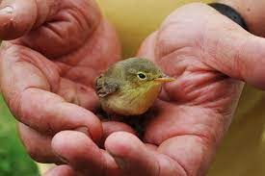
THE SPIRIT OF FOUNTAINGATE
Text: Nehemiah 2:11-20

Slide 3
There is no doubt that this message is important to understand, accept and follow if we are to continue in God’s compassionate leading of this church

Slide 4
I. THE SURVEILLANCE Nehemiah 2:11-16
“By night I went out through the Valley Gate toward the Jackal Well and the Dung Gate, examining the walls of Jerusalem, which had been broken down, and its gates, which had been destroyed by fire.
Nehemiah 2:13

Slide 5
I. THE SURVEILLANCE Nehemiah 2:11-16
14. Then I moved on toward the Fountain Gate and the King’s Pools, but there was not enough room for my mount to get through;
Nehemiah 2:14

Slide 6
I. THE SURVEILLANCE Nehemiah 2:11-16
15. So I went up the Valley by night, examining the wall. Finally I turned back and re-entered through the Valley Gate.”
Nehemiah 2:15

Slide 7
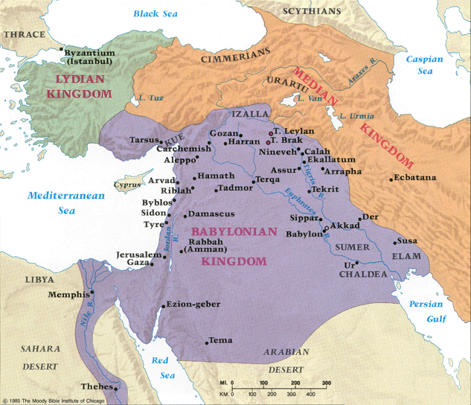
The Kingdom of the Medes & Persians

Slide 8
I. THE SURVEILLANCE Nehemiah 2:11-16
A. The Gates and the Walls – II Samuel 5:9; I Kings 9:15,24

Slide 9
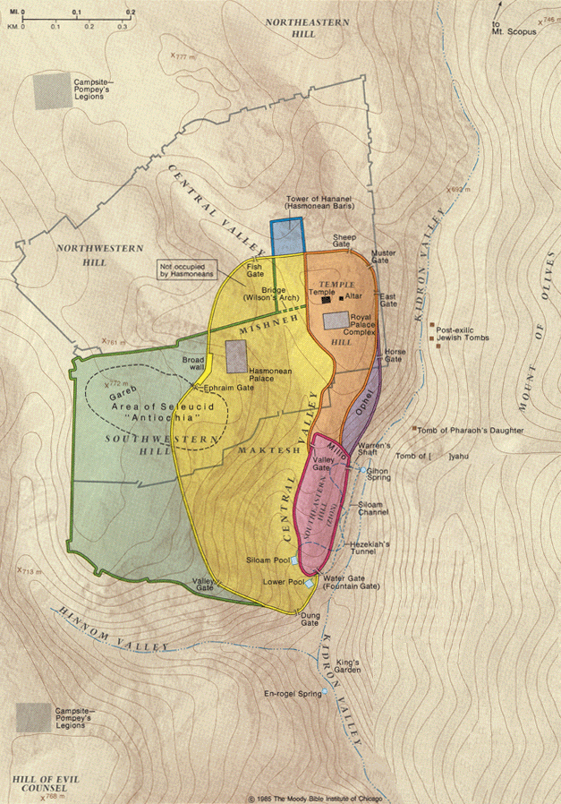
The Gates & Walls

Slide 10
I. THE SURVEILLANCE Nehemiah 2:11-16
A. The Gates and the Walls – II Samuel 5:9;
I Kings 9:15,24
B. The Pool of Siloam

Slide 11
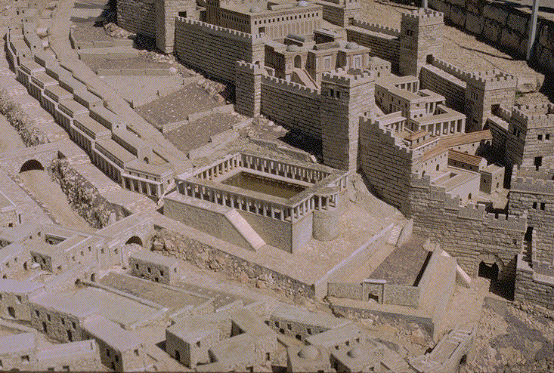
The Pool of Siloam

Slide 12
I. THE SURVEILLANCE Nehemiah 2:11-16
A. The Gates and the Walls – II Samuel 5:9;
I Kings 9:15,24
B. The Pool of Siloam
C. The Gihon Spring

Slide 13
The Gihon Spring

Slide 14
I. THE SURVEILLANCE Nehemiah 2:11-16
A. The Gates and the Walls – II Samuel 5:9;
I Kings 9:15,24
B. The Pool of Siloam
C. The Gihon Spring
D. The Aqueduct of Siloam – Nehemiah 2:14; II Kings 20:20

Slide 15
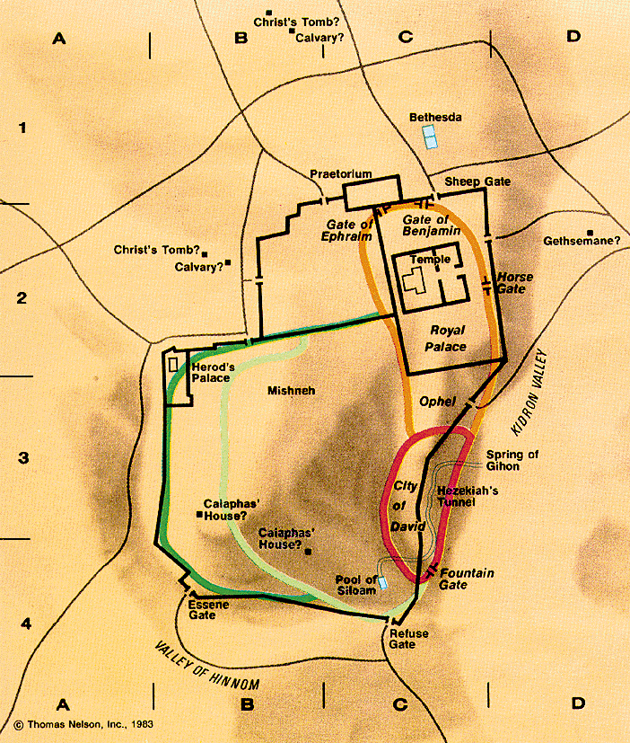

Slide 16
I. THE SURVEILLANCE Nehemiah 2:11-16
“As for the other events of Hezekiah’s reign, all his achievements and how he made the pool and the tunnel by which he brought water into the city, are they not written in the book of the annals of the kings of Judah?
II Kings 20: 20

Slide 17
II. THE SIGNIFICANCE Nehemiah 2:11-16
“there is a proper time and procedure for every matter“
Ecclesiastes 8:6a

Slide 18
II. THE SIGNIFICANCE Nehemiah 2:11-16
“You saw the City of David had many breaches in its defenses; you stored up water in the Lower Pool (Pool of Siloam).
10. You counted the buildings in Jerusalem and tore down houses to strengthen the wall.
Isaiah 22:9-10

Slide 19
II. THE SIGNIFICANCE Nehemiah 2:11-16
11. You built a reservoir between the two walls for the water of the Old Pool, but you did not look to the One who made it, or regard the One who planned it long ago.
Isaiah 22:11

Slide 20
II. THE SIGNIFICANCE Nehemiah 2:11-16
12. The Lord, the Lord Almighty, called you on that day to weep and to wail, to tear out your hair and put on sackcloth.
13. But see, there is joy and revelry, slaughtering of cattle and killing of sheep, eating of meat and drinking of wine!‘ Let us eat and drink,’ you say, ‘for tomorrow we die!’”
Isaiah 22:12-13

Slide 21
II. THE SIGNIFICANCE Nehemiah 2:11-16
“The LORD spoke to me again:
6. ‘Because this people has rejected the gently flowing waters of Shiloah (Gihon Spring flowing into the Pool of Siloam) and rejoices over Rezin and the son of Remaliah,”
Isaiah 8:5-6

Slide 22
II. THE SIGNIFICANCE Nehemiah 2:11-16
7. Therefore the Lord is about to bring against them the mighty floodwaters of the River (the Euphrates) - the king of Assyria with all his pomp. It will overflow all its channels, run over all its banks
8. And sweep on into Judah, swirling over it, passing through it and reaching up to the neck. Its outspread wings will cover the breadth of your land, O Immanuel!”
Isaiah 8:7-8

Slide 23
II. THE SIGNIFICANCE Nehemiah 2:11-16
7. Therefore the Lord is about to bring against them the mighty floodwaters of the River (the Euphrates) - the king of Assyria with all his pomp. It will overflow all its channels, run over all its banks
8. And sweep on into Judah, swirling over it, passing through it and reaching up to the neck. Its outspread wings will cover the breadth of your land, O Immanuel!”
Isaiah 8:7-8

Slide 24
II. THE SIGNIFICANCE Nehemiah 2:11-16
“On the last and greatest day of the Feast (of Tabernacles), Jesus stood and said in loud voice, ‘If anyone is thirsty, let him come to me and drink.
38. Whoever believes in me, as the Scripture has said, streams of living water will flow from within him.”
John 7:37,38

Slide 25
II. THE SIGNIFICANCE Nehemiah 2:11-16
“But the wisdom that comes from heaven is first of all pure; then peace-loving, considerate, submissive, full of mercy and good fruit, impartial and sincere.”
James 3:17

