Slide 1
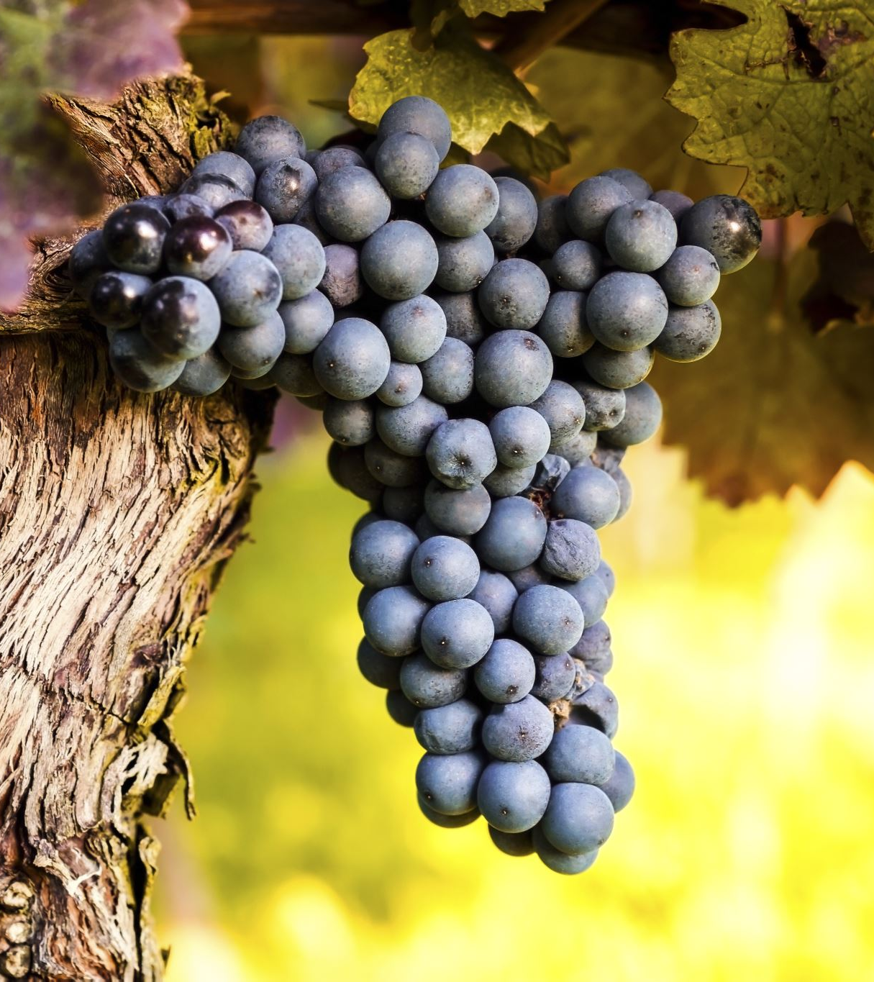
THE TRUE VINE
John 15: 1-11

Slide 2
I. THE PERSONALITY OF THE TRUE VINE
THE GENUINENESS OF THE TRUE VINE
THE GARDENER OF THE TRUE VINE

Slide 3
I. THE PERSONALITY OF THE TRUE VINE
LIKE A MIRROR,
REVEALS PROBLEMS
LIKE A KNIFE,
CUTS TO THE HEART
”Anyone who listens to the word but does not do what it says is like someone who looks at his face in a mirror and, after looking at himself, goes away and immediately forgets what he looks like.”
James 1:23-24
“For the word of God is alive and active. Sharper than any double-edged sword, it penetrates even to dividing soul and spirit, joints and marrow; it judges the thoughts and attitudes of the heart.”
Hebrews 4:12

Slide 4
II. THE PURPOSE OF THE TRUE VINE
THERE IS A DISTINCT PURPOSE
THERE IS A DESTINGUISHED PURPOSE

Slide 5
II. THE PURPOSE OF THE TRUE VINE
3. THERE IS A DELEGATED PURPOSE
ATTACHED TO THE VINE
ABIDE IN THE VINE
AVAILABLE TO THE VINE

Slide 6
III. THE PROMISE OF THE TRUE VINE
AN UNHINDERED PRAYER LIFE
AN UNENDING LOVE
AN UNCOMMON JOY

Slide 7
III. THE PROMISE OF THE TRUE VINE
- JOY IS DIVINE IN NATURE
-JOY IS NOT DEPENDENT UPON HAPPINESS
-JOY IS THE PRODUCT OF FAITH
-JOY IN THE LORD PRODUCES FAITHFULNESS TO THE LORD

Slide 8
ARE YOU ABIDING IN THE VINE?

