Slide 1
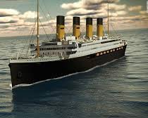
The Unsinkable Ship
Luke 12:20

Slide 2
“But God said to him, “You Fool! You will die this very night. Then who will get everything you worked for? - Luke 12:20 (NLT)

Slide 3
The Titanic
“The Unsinkable Ship”

Slide 4
The Ship Sank On It’s Maiden Voyage

Slide 5
“Give us help from trouble: for Vain is the help of man.” - Psalms 60:11 KJV

Slide 6
“Thou Fool! This night thy soul shall be required of thee.” – Luke 12:20 KJV

Slide 7
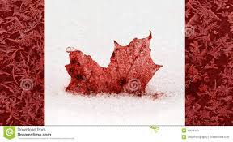
Canada is Sinking like the Titanic….

Slide 8
April 14, 1912 @ 11:40pm…..

Slide 9
I. False Security

Slide 10
Only 20 Lifeboats Available…. Each held 58 People.. Only Save 1180 People… 2340 On Board

Slide 11
“Take life easy; eat, drink, and be merry!” Luke 12:19 NIV

Slide 12
JOHN JACOB ASTOR IV & HIS 19 YEAR OLD BRIDE, MADELAINE
WORTH $150 MILLION

Slide 13
BENJAMIN GUGGENHEIM
HEAD OF THE AMERCIAN SMELTING & REFINING COMPANY
WORTH $95 MILLION

Slide 14
ISADORE & IDA STRAUS
OWNERS OF LEVIS
WORTH $50 MILLION

Slide 15
JAY BRUCE ISMAY
HEAD OF THE INTERNATIONAL MERCANTILE MARINE COMPANY
WORTH $40 MILLION

Slide 16
“Wealth is worthless in the day of wrath, but righteousness delivers from death.” -Proverbs 11:4 NIV

Slide 17
II. Unprepared

Slide 18
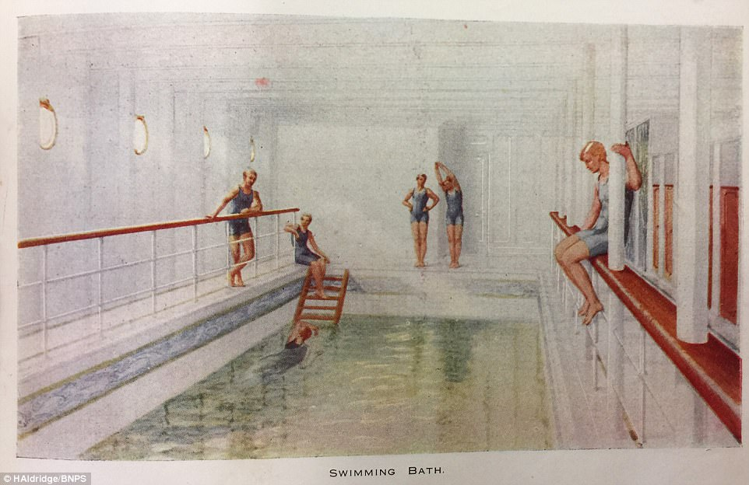
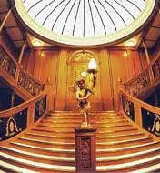
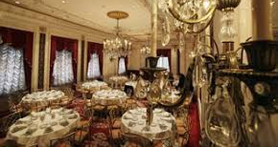
The Luxurious Titanic

Slide 19
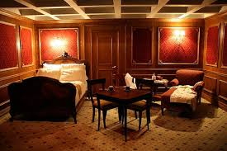
Luxurious Suites $4300
Mechanical Horses

Slide 20
NOT ENOUGH LIFEBOATS….

Slide 21
“And as it was in the days of Noah, so shall it be also in the days of the Son of man. They did eat, they drank, they married wives, they were given in marriage, until the day that Noah entered into the ark, and the flood came, and destroyed them all.” -Luke 17:26-27

Slide 22
“This is how it will be at the coming of the Son of Man.” Matthew 24:39

Slide 23
“Anyone whose name was not found written in the book of life was thrown into the lake of fire.” – Revelation 20:15 NIV “Then they will go away to eternal punishment, but the righteous to eternal life.” – Matthew 25:46 NIV

Slide 24
III. PROCRASTINATION

Slide 25
“As it was in the days of Lot; they did eat, they drank, they bought, they sold, they planted, they built; But the same day that Lot went out of Sodom it rained fire and brimstone from heaven and destroyed them all.” – Luke 17:28-29

Slide 26
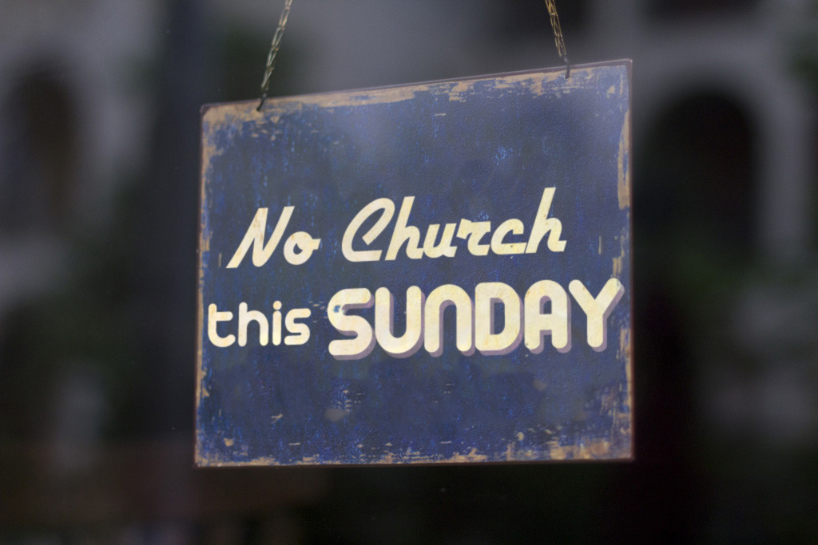
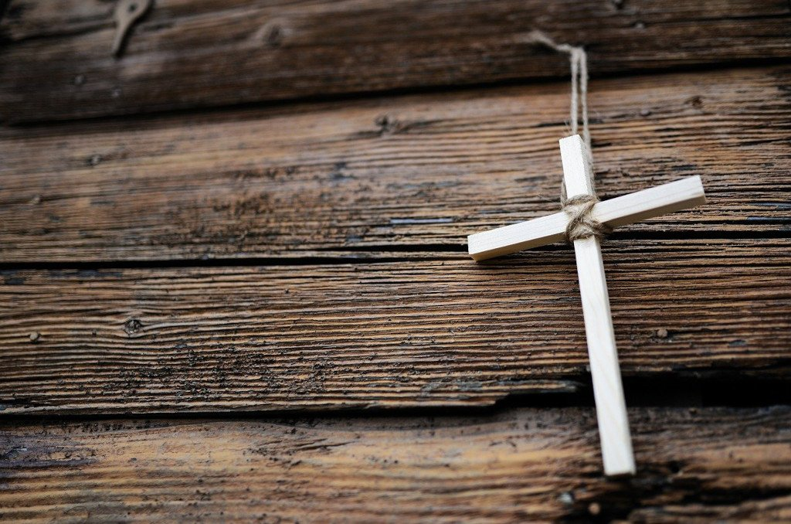
Will Make time for…

Slide 27
“They too will drink the wine of God’s fury, which has been poured full strength into the cup of his wrath. They will be tormented with burning sulfur in the presence of the holy angels and of the Lamb. And the smoke of their torment will rise forever and ever. There will be no rest day or night for those who worship the beast and its image, or for anyone who receives the mark of its name. -Revelation 14:10-11

Slide 28
IV. THEY CRIED OUT

Slide 29
“Therefore, disaster will overtake him in an instant; he will suddenly be destroyed – without remedy.” – Proverbs 6:15 “Whoever remains stiff necked after many rebukes will suddenly be destroyed – without remedy.” – Proverbs 29:1

Slide 30
Reverend Harper said, “You will need this more than I do!”

Slide 31
“This is love, not that we loved God, but that He loved us, and sent His Son as an atoning sacrifice for our sins.” – 1 John 4:10

Slide 32
Will you trust me? - Jesus

