Slide 1
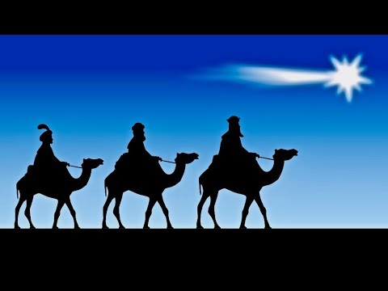
THE WISE STILL SEEK AFTER HIM
Text: Matthew 2:1-12

Slide 2
Balthasar is often represented as a king of Arabia or sometimes Ethiopia, Melchior as a king of Persia, and Gaspar as a king of India.

Slide 3
I. THEY WILL PAY THE PRICE A. They Will Travel the Distance

Slide 4
“And whoever does not carry their cross and follow me cannot be my disciple. 28. Suppose one of you wants to build a tower. Won’t you first sit down and estimate the cost to see if you have enough money to complete it?

Slide 5
29. For if you lay the foundation and are not able to finish it, everyone who sees it will ridicule you, 30. saying, ‘This person began to build and wasn’t able to finish.’

Slide 6
31. “Or suppose a king is about to go to war against another king. Won’t he first sit down and consider whether he is able with ten thousand men to oppose the one coming against him with twenty thousand?

Slide 7
32. If he is not able, he will send a delegation while the other is still a long way off and will ask for terms of peace. 33. In the same way, those of you who do not give up everything you have cannot be my disciples. Luke 14:27-33

Slide 8
I. THEY WILL PAY THE PRICE B. They will Offer a Meaningful Gift

Slide 9
I. THEY WILL PAY THE PRICE B. They will Offer a Meaningful Gift 1. Gold

Slide 10
I. THEY WILL PAY THE PRICE B. They will Offer a Meaningful Gift 2. Frankincense

Slide 11
I. THEY WILL PAY THE PRICE B. They will Offer a Meaningful Gift 3. Myrrh

Slide 12
II. THEY WILL BOTH SEE GOD’S SIGNS AND HEAR GOD’S VOICE

Slide 13
“Where is the one who is born king of the Jews? We saw his star when it rose and have come to worship him . . 7. Then Herod called the Magi secretly and found out from them the exact time the star appeared .

Slide 14
9. After they had heard the king, they went on their way, and the star they had seen when it rose went ahead of them until it stopped over the place where the child was,

Slide 15
“Where is the one who is born king of the Jews? We saw his star when it rose and have come to worship him . . 7. Then Herod called the Magi secretly and found out from them the exact time the star appeared .

Slide 16
10. When they saw the star, they were overjoyed.” Matthew 2:2,7,9,10

Slide 17
“The heavens declare the glory of God; the skies proclaim the work of his hands. 2. Day after day they pour forth speech; night after night they display knowledge.

Slide 18
3. There is no speech or language where their voice is not heard. 4. Their voice goes out into all the earth, their words to the ends of the world;” Psalm 19:1-4

Slide 19
In the last days . . . 19. I will show wonders in the heavens above and signs on the earth below, blood and fire and billows of smoke. 20. The sun will be turned to darkness and the moon to blood before the coming of the great and glorious day of the Lord. Acts 2:17,19,20

Slide 20
A. Herod Was Puzzled and Brought Fear among the People

Slide 21
B. The Magi were Overjoyed “ And having been warned in a dream not to go back to Herod, they returned to their country by another route.” Matthew 2:12

