Slide 1
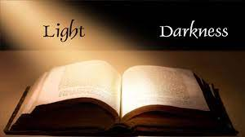
TWO IN ONE?
Text:
I Corinthians 4:1-5

Slide 2
“When Jesus heard that John had been put in prison, he withdrew to Galilee.
13. Leaving Nazareth, he went and lived in Capernaum, which was by the lake in the area of Zebulun and Naphtali—
14. to fulfill what was said through the prophet Isaiah:
15. “Land of Zebulun and land of Naphtali, the Way of the Sea, beyond the Jordan, Galilee of the Gentiles—
16. the people living in darkness have seen a great light; on those living in the land of the shadow of death a light has dawned.”
17. From that time on Jesus began to preach “Repent for the kingdom of heaven has come hear.”
Matthew 4:12-17

Slide 3
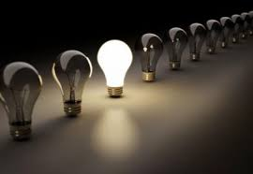
“The light shines in the darkness, and the darkness has not overcome it.”
John 1:5
“This is the message we have heard from him and declare to you: God is light; in him there is no darkness at all.”
I John 1:5

Slide 4
I. LIGHT AND DARKNESS ARE TOTALLY SEPARATE
“When Jesus spoke again to the people, he said, “I am the light of the world. Whoever follows me will never walk in darkness, but will have the light of life.”
John 8:12
“Arise, shine, for your light has come, and the glory of the LORD rises upon you.”
Isaiah 60:1

Slide 5
I. LIGHT AND DARKNESS ARE TOTALLY SEPARATE
“Are not my few days almost over? Turn away from me so I can have a moment’s joy
21. before I go to the place of no return, to the land of gloom and utter darkness,
22. to the land of deepest night, of utter darkness and disorder, where even the light is like darkness.”
Job 10:20-22
HELL

Slide 6
I. LIGHT AND DARKNESS ARE TOTALLY SEPARATE
“But the subjects of the kingdom (Jews who foolishly believed that because of their ancestry that they had inherited a passport to heaven) will be thrown outside, into the darkness, where there will be weeping and gnashing of teeth.”
Matthew 8:12
HELL

Slide 7
I. LIGHT AND DARKNESS ARE TOTALLY SEPARATE
What is killing people?
●Drugs,
●High levels of alcohol,
●Abortion,
●Euthanasia,
●Infanticide,
●AIDS,
●Corruption in all levels or authority worldwide,
●Laboratory created pandemics,
●Ungodly lifestyles that the Bible says are an abomination to God.

Slide 8
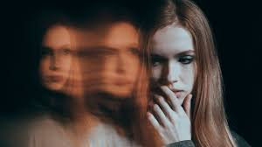
II. UNGODLINESS AND RIGHTEOUSNESS CANNOT DWELL TOGETHER
“Therefore judge nothing before the appointed time; wait until the Lord comes. He will bring to light what is hidden in darkness and will expose the motives of the heart. At that time each will receive their praise from God.
I Corinthians 4:5-6

Slide 9
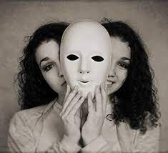
II. UNGODLINESS AND RIGHTEOUSNESS CANNOT DWELL TOGETHER
“. . . Satan himself masquerades as an angel of light.
15. It is not surprising, then, if his servants also masquerade as servants of righteousness. Their end will be what their actions deserve.”
II Corinthians 11:14-15

Slide 10
II. UNGODLINESS AND RIGHTEOUSNESS CANNOT DWELL TOGETHER
“Do not be yoked together with unbelievers. For what do righteousness and wickedness have in common? Or what fellowship can light have with darkness?
15. What harmony is there between Christ and Belial? Or what does a believer have in common with an unbeliever?
16. What agreement is there between the temple of God and idols? For we are the temple of the living God.
II Corinthians 6:14-16

Slide 11
II. UNGODLINESS AND RIGHTEOUSNESS CANNOT DWELL TOGETHER
“Out of the same mouth come praise and cursing. My brothers and sisters, this should not be.
11. Can both fresh water and salt water flow from the same spring?
12. My brothers and sisters, can a fig tree bear olives, or a grapevine bear figs? Neither can a salt spring produce fresh water.” James 3:10-12

Slide 12
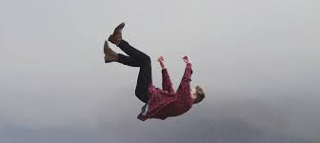
II. UNGODLINESS AND RIGHTEOUSNESS CANNOT DWELL TOGETHER
“So then, dear friends, since you are looking forward to this, make every effort to be found spotless, blameless and at peace with him.
17. Therefore, dear friends, since you have been forewarned, be on your guard so that you may not be carried away by the error of the lawless and fall from your secure position.
II Peter 3:14,17

Slide 13
II. UNGODLINESS AND RIGHTEOUSNESS CANNOT DWELL TOGETHER
“These people are springs without water and mists driven by a storm. Blackest darkness is reserved for them.
18. For they mouth empty, boastful words and, by appealing to the lustful desires of the flesh, they entice people who are just escaping from those who live in error.
19. They promise them freedom, while they themselves are slaves of depravity—for “people are slaves to whatever has mastered them.” II Peter 2:17-19

Slide 14
II. UNGODLINESS AND RIGHTEOUSNESS CANNOT DWELL TOGETHER
20. If they have escaped the corruption of the world by knowing our Lord and Savior Jesus Christ and are again entangled in it and are overcome, they are worse off at the end than they were at the beginning.
21. It would have been better for them not to have known the way of righteousness, than to have known it and then to turn their backs on the sacred command that was passed on to them.
22. Of them the proverbs are true: “A dog returns to its vomit,” and, “A sow that is washed returns to her wallowing in the mud.”
II Peter 2:17-22

Slide 15
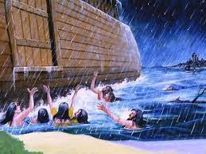
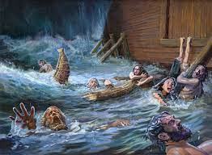
II. UNGODLINESS AND RIGHTEOUSNESS CANNOT DWELL TOGETHER
There is going to be
a day of closure very soon.

