Slide 1
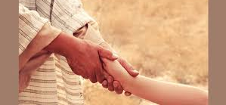
The Compassionate Christ
Matthew 9:36-38

Slide 2
I. THE ORIGINS OF HIS COMPASSION
ORIGINATED
IN HIS
ESSENCE
No one has ever seen God, but the one and only Son, who is himself God and is in closest relationship with the Father, has made him known. “
John 1:18

Slide 3
I. THE ORIGINS OF HIS COMPASSION
B) ORIGINATED
IN HIS
EXPERIENCES
Jesus replied, “Foxes have dens and birds have nests, but the Son of Man has no place to lay his head.”
Matthew 8:20

Slide 4
II. THE OBJECTS OF HIS COMPASSION
He Feels Compassion for….
The Scattered Ones
The Sinning Ones
The Sick Ones
The Suffering Ones
The Seeking Ones

Slide 5
How do WE see people?

Slide 6
III. THE OBJECTIVES OF HIS COMPASSION
A) The Objective
of
Instruction

Slide 7
DID YOU FALL IN?

Slide 8
III. THE OBJECTIVES OF HIS COMPASSION
B) The Objective
of
Involvement

Slide 9
Why are you doing that?

Slide 10
A Little Compassion Accomplishes Big Things

