Slide 1
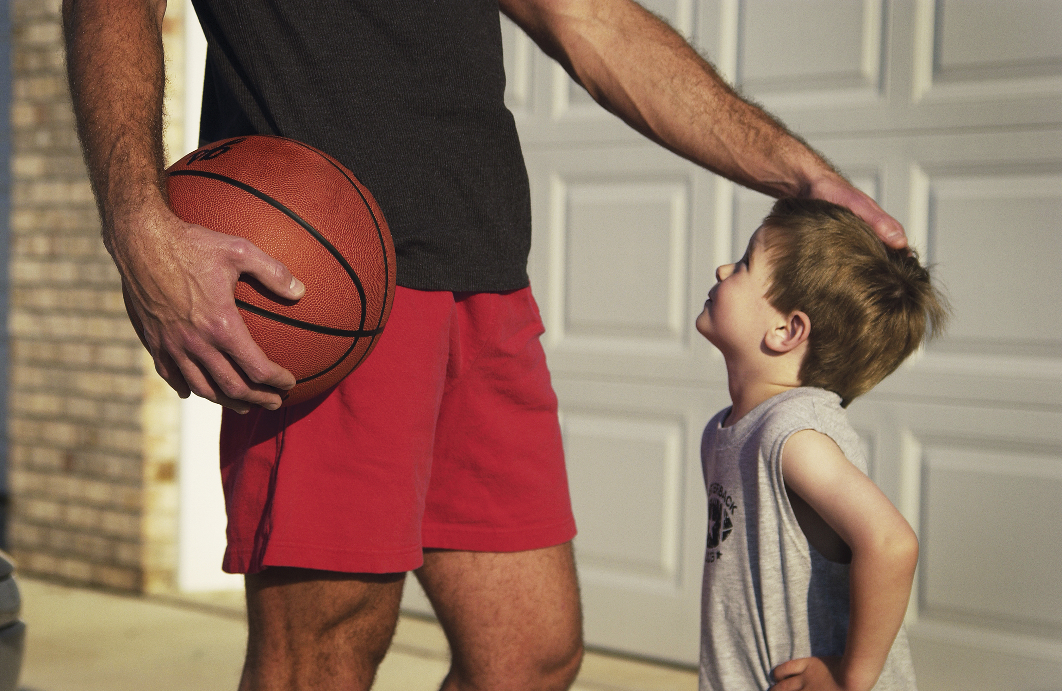
The Father’s Example
Matthew 3:13-17

Slide 2
Matthew 3:13-17 Then Jesus came from Galilee to the Jordan to be baptized by John. But John tried to deter him, saying, “I need to be baptized by you, and do you come to me?” Jesus replied, “Let it be so now; it is proper for us to do this to fulfill all righteousness.” Then John consented. As soon as Jesus was baptized, he went up out of the water. At that moment heaven was opened, and he saw the Spirit of God descending like a dove and alighting on him. And a voice from heaven said, “This is my Son, whom I love; with him I am well pleased.”

Slide 3
The way our children see us, is how they will see God!

Slide 4
I. THE FATHER IS NOT ASHAMED OF HIS SON
Hebrews 2:11
Both the one who makes people holy and those who are made holy are of the same family. So, Jesus is not ashamed to call them brothers and sisters.
Hebrews 11:16
Instead, they were longing for a better country—a heavenly one. Therefore, God is not ashamed to be called their God, for he has prepared a city for them.

Slide 5
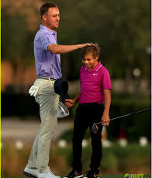
OUR CHILDREN NEED TO KNOW WE ARE PROUD OF THEM

Slide 6
II. THE FATHER ADORES THE SON
John 5:20
For the Father loves the Son and shows him all he does. Yes, and he will show him even greater works than these, so that you will be amazed.

Slide 7
Jeremiah 31:3 The Lord appeared to us in the past, saying: “I have loved you with an everlasting love; I have drawn you with unfailing kindness. Romans 8:38-39 For I am convinced that neither death nor life, neither angels nor demons, neither the present nor the future, nor any powers, neither height nor depth, nor anything else in all creation, will be able to separate us from the love of God that is in Christ Jesus our Lord.

Slide 8
RESPOND TO YOUR CHILDREN WITH GENUINE DISPLAYS OF LOVE

Slide 9
III. THE FATHER ACCEPTS THE SON
James 1:27
Religion that God our Father accepts as pure and faultless is this: to look after orphans and widows in their distress and to keep oneself from being polluted by the world.

Slide 10
LOVE AND ACCEPT YOUR CHILDREN AS THEY ARE

Slide 11
IV. THE FATHER TEACHES THE SON
2 Timothy 2:1-2
You then, my son, be strong in the grace that is in Christ Jesus. And the things you have heard me say in the presence of many witnesses entrust to reliable people who will also be qualified to teach others.

Slide 12
I’ll help you….

Slide 13
Do you remember your father?

Slide 14
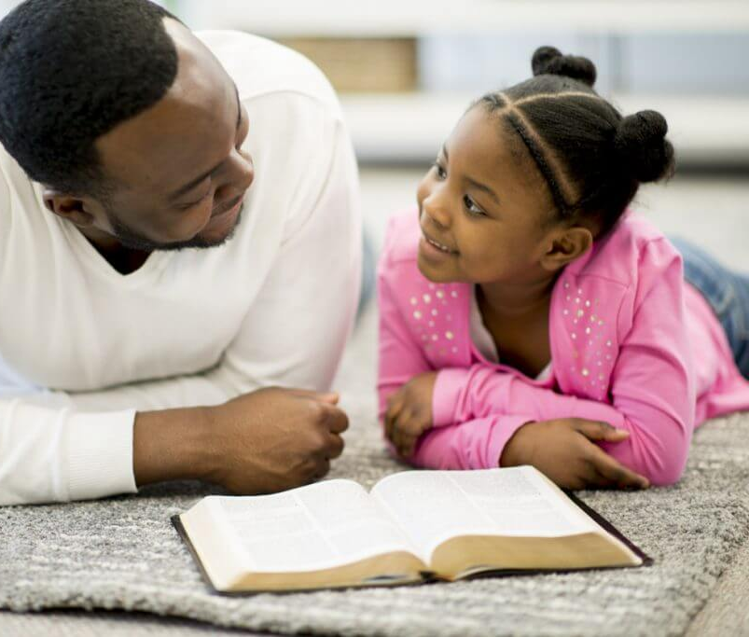
POINT YOUR CHILDREN TO JESUS

Slide 15
ROOM FOR IMPROVEMENT??

