Slide 1
The God of the Impossible
Jeremiah 32:16-27; 33:3

Slide 2
Jeremiah 32:16-27 “After I had given the deed of purchase to Baruch son of Neriah, I prayed to the LORD: “Ah, Sovereign LORD, you have made the heavens and the earth by your great power and outstretched arm. Nothing is too hard for you. You show love to thousands but bring the punishment for the parents’ sins into the laps of their children after them. Great and mighty God, whose name is the LORD Almighty, great are your purposes and mighty are your deeds. Your eyes are open to the ways of all mankind; you reward each person according to their conduct and as their deeds deserve. You performed signs and wonders in Egypt and have continued them to this day, in Israel and among all mankind, and have gained the renown that is still yours. You brought your people Israel out of Egypt with signs and wonders, by a mighty hand and an outstretched arm and with great terror. You gave them this land you had sworn to give their ancestors, a land flowing with milk and honey. They came in and took possession of it, but they did not obey you or follow your law; they did not do what you commanded them to do. So, you brought all this disaster on them. “See how the siege ramps are built up to take the city. Because of the sword, famine and plague, the city will be given into the hands of the Babylonians who are attacking it. What you said has happened, as you now see. And though the city will be given into the hands of the Babylonians, you, Sovereign LORD, say to me, ‘Buy the field with silver and have the transaction witnessed. Then the word of the LORD came to Jeremiah: “I am the LORD, the God of all mankind. Is anything too hard for me?

Slide 3
Jeremiah was sent to Preach Judgement

Slide 4
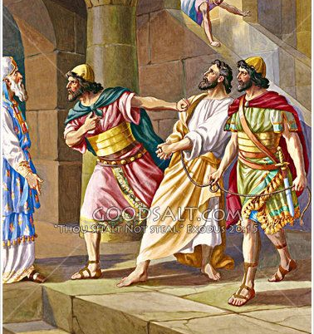
Jeremiah was thrown into prison..

Slide 5
I. JEREMIAH’S CONFIDENCE

Slide 6
I. JEREMIAH’S CONFIDENCE
A. GOD’S CREATION
B. GOD’S POWER

Slide 7
I. JEREMIAH’S CONFIDENCE
C. GOD’S CHARACTER
D. GOD’S CONVERSION

Slide 8
II. JEREMIAH’S CRISIS
A. PROBLEMS HE FACED

Slide 9
II. JEREMIAH’S CRISIS
B. THE PLAN HE FOLLOWED

Slide 10
II. JEREMIAH’S CRISIS
C. THE PREDICAMENT HE FEARED

Slide 11
III. JEREMIAH’S COMFORT
A. HE WAS COMFORTED BY GOD’S POWER

Slide 12
III. JEREMIAH’S COMFORT
B. HE WAS COMFORTED BY GOD’S PROMISES

Slide 13
“I will bow down toward your holy temple and will praise your name for your unfailing love and your faithfulness, for you have so exalted your solemn decree that it surpasses your fame,” Psalms 138:2 “For truly I tell you, until heaven and earth disappear, not the smallest letter, not the least stroke of a pen, will by any means disappear from the Law until everything is accomplished.” Matthew 5:18 “Heaven and earth shall pass away, but my words shall not pass away,” Matthew 24:35

Slide 14
III. JEREMIAH’S CRISIS
C. HE WAS COMFORTED BY GOD’S PROCLAMATION

Slide 15
“Ask and it will be given to you; seek and you will find; knock and the door will be opened to you. For everyone who asks receives; the one who seeks finds; and to the one who knocks, the door will be opened. “Which of you, if your son asks for bread, will give him a stone? Or if he asks for a fish, will give him a snake? If you, then, though you are evil, know how to give good gifts to your children, how much more will your Father in heaven give good gifts to those who ask him!” Matthew 7:7-11 “This is the confidence we have in approaching God: that if we ask anything according to his will, he hears us. And if we know that he hears us—whatever we ask—we know that we have what we asked of him.” 1 John 5:14-15

Slide 16
WHAT ARE YOU FACING TODAY?

