Slide 1
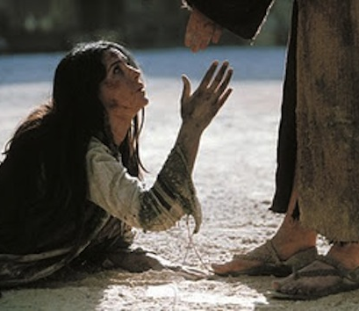
The Guilty Woman
John 8:1-11

Slide 2
i. The sinner and her guilt
A) THE WOMAN AND HER SIN
“The very act of adultery.”

Slide 3
As it is written: “There is no one righteous, not even one; there is no one who understands; there is no one who seeks God. All have turned away; they have together become worthless. there is no one who does good, not even one.” “Their throats are open graves; their tongues practice deceit.” “The poison of vipers is on their lips.” “Their mouths are full of cursing and bitterness.” “Their feet are swift to shed blood; ruin and misery mark their ways, and the way of peace they do not know.” “There is no fear of God before their eyes.” Romans 3:10-18 NIV

Slide 4
i. The sinner and her guilt
B) THE WOMAN AND HER SHAME
“The eyes of the Lord are everywhere, keeping watch on the wicked and the good.”
Proverbs 15:3

Slide 5
i. The sinner and her guilt
C) THE WOMAN AND HER SENTENCE
Engaged = Stoned
Married = Strangled
Daughter of Priest = Burned

Slide 6
II. THE SOLICITORS AND THEIR DECEIT
A) THEIR SHAMEFUL SCHEME

Slide 7
II. THE SOLICITORS AND THEIR DECEIT
B) THEIR SHOCKING SETBACK
1. HOW JESUS REACTED TO THEM

Slide 8
II. THE SOLICITORS AND THEIR DECEIT
B) THEIR SHOCKING SETBACK
2. WHAT JESUS REVEALED ABOUT THEM

Slide 9
III. THE SAVIOUR AND HIS GRACE
“BUT JESUS KNELT DOWN”
*CONFRONTED HER
*CLEANSED HER
*COMPLETED HER

Slide 10
NO SINNER IS TOO FAR GONE…. NO ONE’S GUILT IS TOO DEEP…. NO ONE IS BEYOND THE REACH OF THE GRACE OF GOD!
HOPE AMID HOPELESSNESS

