Slide 1
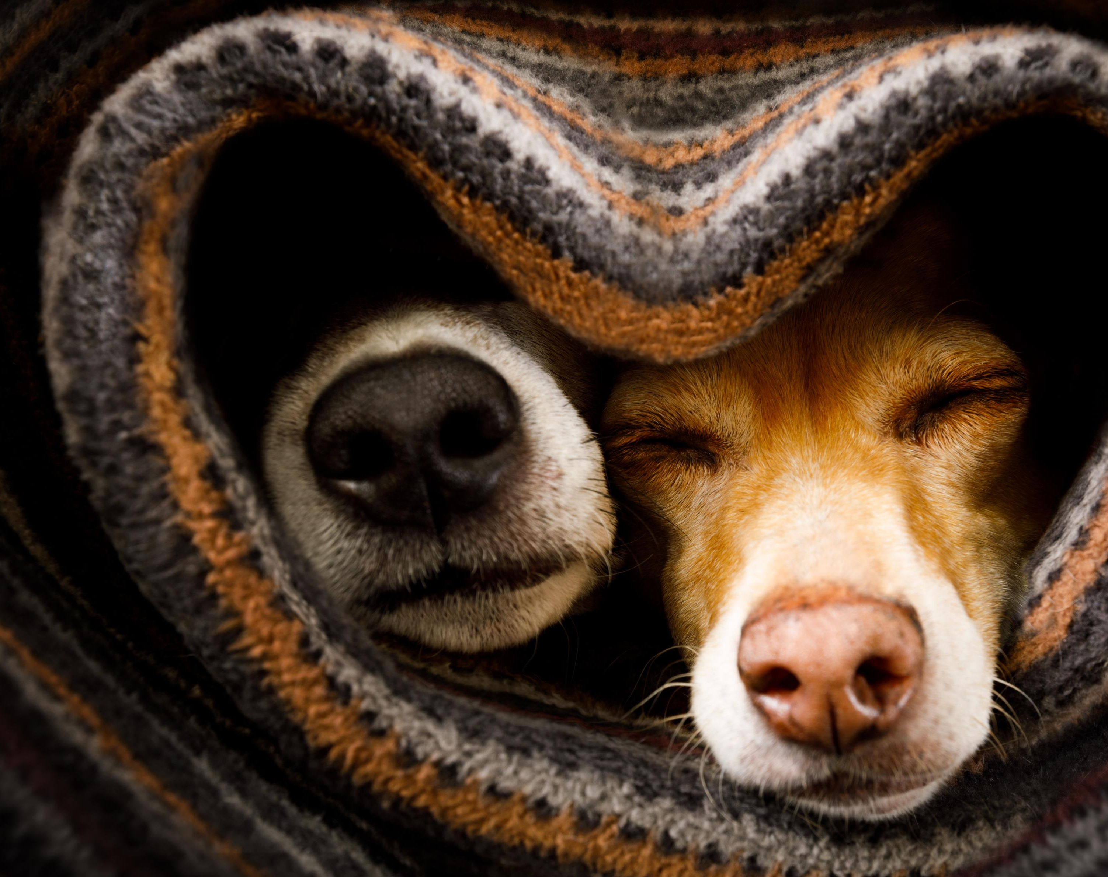
The Heart of Friendship
1 Samuel 18:1-4

Slide 2
1 Samuel 20:27-42 But the next day, the second day of the month, David's place was empty again. Then Saul said to his son Jonathan, "Why hasn't the son of Jesse come to the meal, either yesterday or today?" Jonathan answered, "David earnestly asked me for permission to go to Bethlehem. He said, 'Let me go, because our family is observing a sacrifice in the town and my brother has ordered me to be there. If I have found favor in your eyes, let me get away to see my brothers.' That is why he has not come to the king's table."

Slide 3
1 Samuel 20:27-42 Saul's anger flared up at Jonathan and he said to him, "You son of a perverse and rebellious woman! Don't I know that you have sided with the son of Jesse to your own shame and to the shame of the mother who bore you? As long as the son of Jesse lives on this earth, neither you nor your kingdom will be established. Now send and bring him to me, for he must die!" "Why should he be put to death? What has he done?" Jonathan asked his father. But Saul hurled his spear at him to kill him.

Slide 4
1 Samuel 20:27-42 Jonathan got up from the table in fierce anger; on that second day of the month he did not eat, because he was grieved at his father's shameful treatment of David. In the morning Jonathan went out to the field for his meeting with David.

Slide 5
1 Samuel 20:27-42 He had a small boy with him, and he said to the boy, "Run and find the arrows I shoot." As the boy ran, he shot an arrow beyond him. When the boy came to the place where Jonathan's arrow had fallen, Jonathan called out after him, "Isn't the arrow beyond you?" Then he shouted, "Hurry! Go quickly! Don't stop!"

Slide 6
1 Samuel 20:27-42 The boy picked up the arrow and returned to his master. (The boy knew nothing of all this; only Jonathan and David knew.) Then Jonathan gave his weapons to the boy and said, "Go, carry them back to town." After the boy had gone, David got up from the south side of the stone and bowed down before Jonathan three times, with his face to the ground. Then they kissed each other and wept together-- but David wept the most.

Slide 7
1 Samuel 20:27-42 Jonathan said to David, "Go in peace, for we have sworn friendship with each other in the name of the LORD, saying, 'The LORD is witness between you and me, and between your descendants and my descendants forever.'" Then David left, and Jonathan went back to the town.”

Slide 8
The Power of Friendship….

Slide 9
Proverbs 12:26

Slide 10
I. Why Having Friends is So Critical

Slide 11
II. What it Means to Be a Real Friend
a) Commitment
b) Openness & Transparency

Slide 12
Paul David Tripp “We live in interwoven networks of terminally casual relationships. We live with the delusion that we know one another, but we really don’t. We call our easygoing, self-protective, and often theological conversations ‘fellowship,’ but they seldom ever reach the threshold of true fellowship.

Slide 13
Paul David Tripp “We know cold demographic details about one another (married or single, type of job, number of kids, general location of housing, etc.), but we know little about the struggle of faith that is waged every day behind well-maintained personal boundaries. One of the things that still shocks me in counseling, is how little I often know about people I have counted as true friends. I can’t tell you how many times, in talking with friends who have come to me for help, that I have been hit with details of difficulty and struggle far beyond anything I would have predicted.”

Slide 14
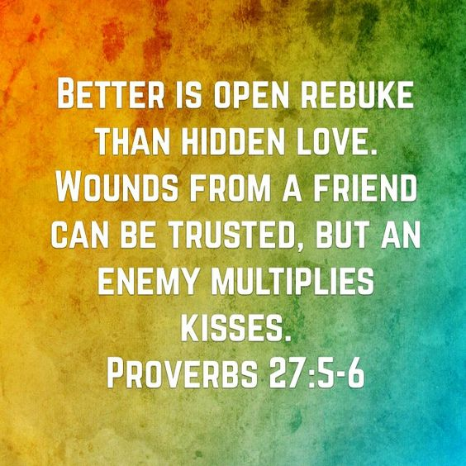

Slide 15
III. Where do You Find This Friendship?
“My command is this: Love each other as I have loved you. Greater love has no one than this, that he lay down his life for his friends. You are my friends if you do what I command. I no longer call you servants, because a servant does not know his master's business . . .
John15:12-17

Slide 16
III. Where do You Find This Friendship?
“Instead, I have called you friends, for everything that I learned from my Father I have made known to you. You did not choose me, but I chose you and appointed you to go and bear fruit-- fruit that will last. Then the Father will give you whatever you ask in my name. This is my command: Love each other.”
John 15:12-17

Slide 17
Jesus is not only the friend that we need, but He teaches us how to be the friend that the people in this world need!

