Slide 1
THE LORDSHIP OF CHRIST PART I & II Dominion over the Nations
Text: Psalm 72:8

Slide 2
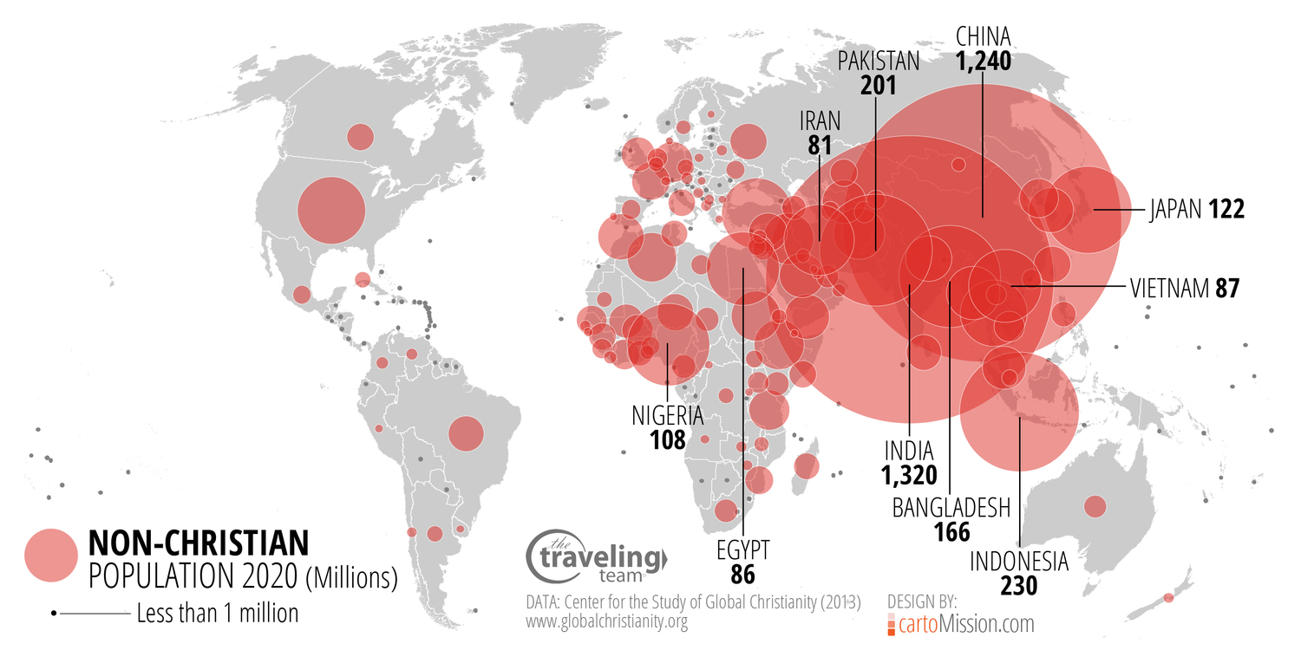
Notes:
Insert a map of your country.

Slide 3
"He shall have dominion also from sea to sea." Psalm 72:8
The East Side of the Peace Tower
Notes:
Insert a map of your country.

Slide 4
“Where there is no vision the people perish.” Proverbs 29:18
The West side of the Peace Tower
Notes:
Insert a map of your country.

Slide 5
“Give the king thy judgements O God and thy righteousness UNto the king’s son.” Psalm 72:1
The South Side of the Peace Tower
Notes:
Insert a map of your country.

Slide 6
The words “from sea to sea” are also engraved on our Coat of Arms.
Notes:
Insert a map of your country.

Slide 7
There Are Specific Steps We must Take to Accomplish the Goals God Has for Us. The Time for Action Is Now.
Notes:
Insert a picture of one of the geographic features of your country.

Slide 8
I. THE STEP OF UNDERSTANDING
"Suppose one of you wants to build a tower. Will he not first sit down and estimate the cost to see if he has enough money to complete it.
29. For if he lays the foundation and is not able to finish it, everyone who sees it will ridicule him,
30. saying, 'This fellow began to build and was not able to finish it."
Luke 14:28-30
Notes:
Insert a picture illustrating a season in your country.

Slide 9
I. THE STEP OF UNDERSTANDING
"Wisdom is supreme; therefore get wisdom. Though it cost all you have, get understanding." (with all thy getting get understanding. -KJV)
Proverbs 4:7
Notes:
Insert a picture illustrating a season in your country.

Slide 10
I. THE STEP OF UNDERSTANDING
“You shall not add to the word which I am commanding you, nor take away from it, that you may keep the commandments of the Lord your God which I command you.”
Deuteronomy 4:2
Notes:
Insert a picture illustrating a season in your country.

Slide 11
I. THE STEP OF UNDERSTANDING
“Whatever (Lit - Everything that) I command you, you shall be careful to do; you shall not add to nor take away from it.”
Deuteronomy 12:32
Notes:
Insert a picture illustrating a season in your country.

Slide 12
I. THE STEP OF UNDERSTANDING
“Every word of God is flawless; he is a shield to those who take refuge in him.
6. Do not add to His words Or He will reprove you, and you will be proved a liar.”
Proverbs 30:5,6
Notes:
Insert a picture illustrating a season in your country.

Slide 13
I. THE STEP OF UNDERSTANDING
“But Peter and John replied, ‘Which is right in God's eyes: to listen to you, or to him? You be the judges!
20. As for us, we cannot help speaking about what we have seen and heard.’"
Acts 4:19,20
Notes:
Insert a picture illustrating a season in your country.

Slide 14
I. THE STEP OF UNDERSTANDING
“But Peter and John replied, ‘Which is right in God's eyes: to listen to you, or to him? You be the judges!
20. As for us, we cannot help speaking about what we have seen and heard.’"
Acts 4:19,20
Notes:
Insert a picture illustrating a season in your country.

Slide 15
II. THE STEP OF UNDERGIRDING
A Vehicle Chassis
Notes:
Insert a picture illustrating a season in your country.

Slide 16
II. THE STEP OF UNDERGIRDING
A Vehicle Frame
Notes:
Insert a picture illustrating a season in your country.

Slide 17
II. THE STEP OF UNDERGIRDING
"Current evangelical popularity presents powerful pressures to compromise biblical values for the sake of social acceptance." Then he adds, "Our degree of compromise has reached epidemic proportions.“
Jon Johnston
Written in 1980
Notes:
Insert a picture illustrating a season in your country.

Slide 18
II. THE STEP OF UNDERGIRDING
"For lack of guidance a nation falls, but many advisers make victory sure." (in the multitude of counselors there is safety - KJV).
Proverbs 11:14
Notes:
Insert a picture illustrating a season in your country.

Slide 19
II. THE STEP OF UNDERGIRDING
“And Peter filled with the Holy Spirit said to them (the rulers and the teachers of the law)”
Acts 4:8
Notes:
Insert a picture illustrating a season in your country.

Slide 20
III. THE STEP OF UNDERTAKING
"If we are to become relevant we must shift from institutionalism to more informal and community centered evangelism and body life . . . God desires that his people become audio-visual demonstrations of the power of His gospel.“
Allan Andrews
Notes:
Insert a picture illustrating a season in your country.

Slide 21
III. THE STEP OF UNDERTAKING
"Some people look at the way things are and ask why; others look at the way things could be and ask why not.“
Robert Kennedy
Notes:
Insert a picture illustrating a season in your country.

Slide 22
III. THE STEP OF UNDERTAKING
“Few men are willing to brave the disapproval of their fellows, the censure of their colleagues, the wrath of their society. Moral courage is a rarer commodity than bravery in battle or great intelligence. Yet it is the one essential, vital quality for those who seek to change a world that yields most painfully to change.”
Robert Kennedy
Notes:
Insert a picture illustrating a season in your country.

