Slide 1
The Mission of Fountaingate –Part II
Gently Offering Health

Slide 2
Mission Statement:
Gently offering Healing, Health and Hope in a Hurting World

Slide 3
1 Thessalonians 5:23
“MAY GOD HIMSELF, THE GOD OF PEACE, SANCTIFY YOU THROUGH AND THROUGH. MAY YOUR WHOLE SPIRIT, SOUL AND BODY BE KEPT BLAMELESS AT THE COMING OF OUR LORD JESUS CHRIST.”

Slide 4
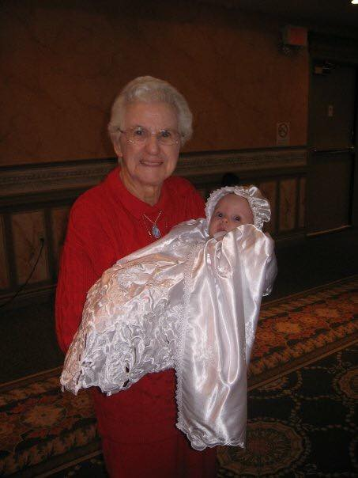
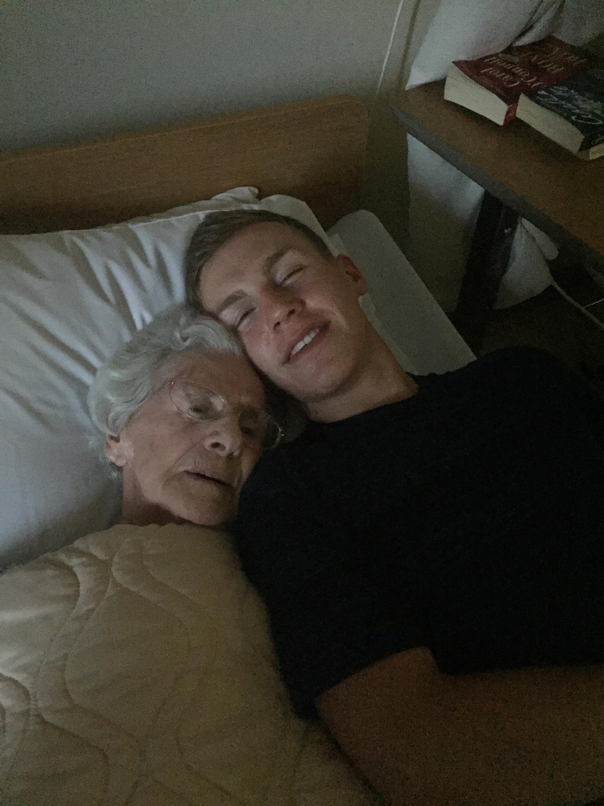
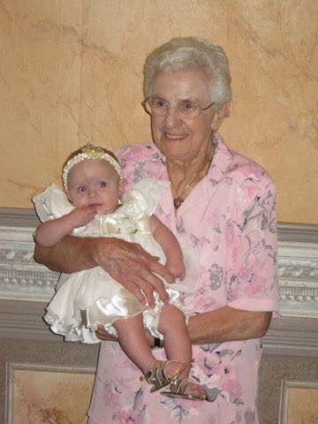
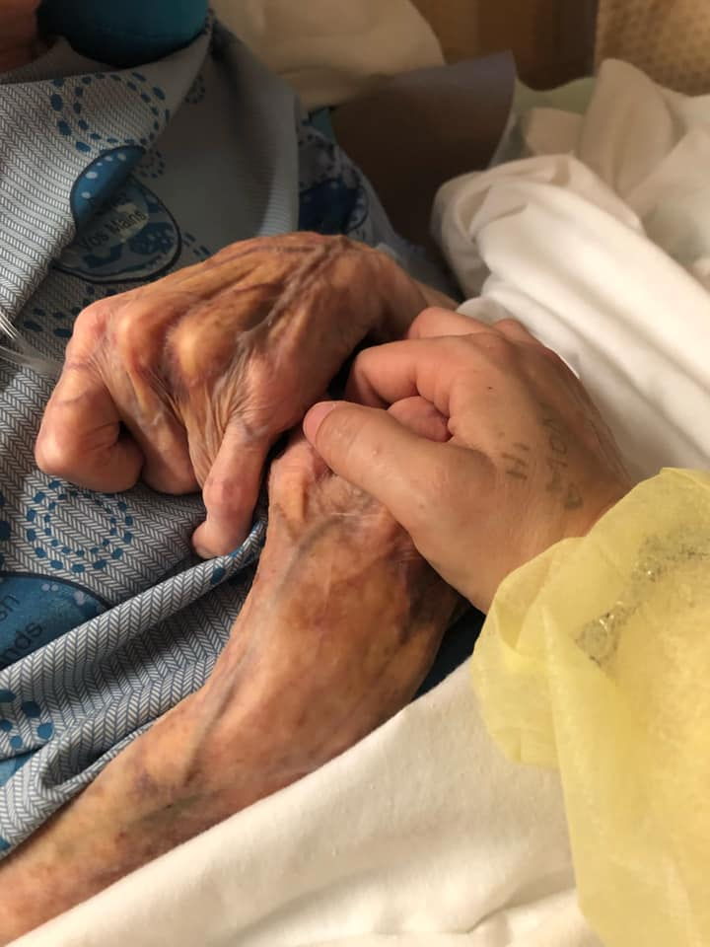
GRANNY “LULA” EAMER
APRIL 23, 1926 – JULY 1, 2021

Slide 5
THE 7 SPHERES OF HEALTH

Slide 6
I. PHYSICAL HEALTH

Slide 7
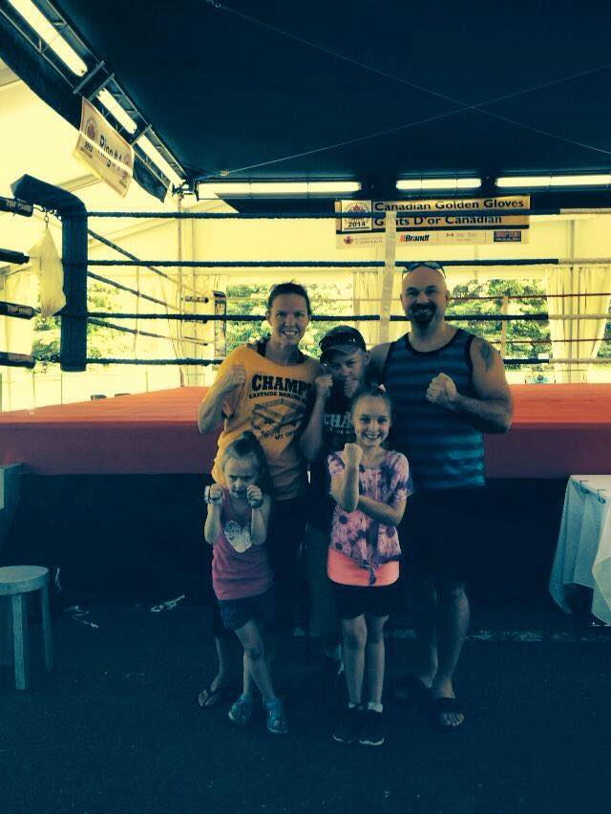
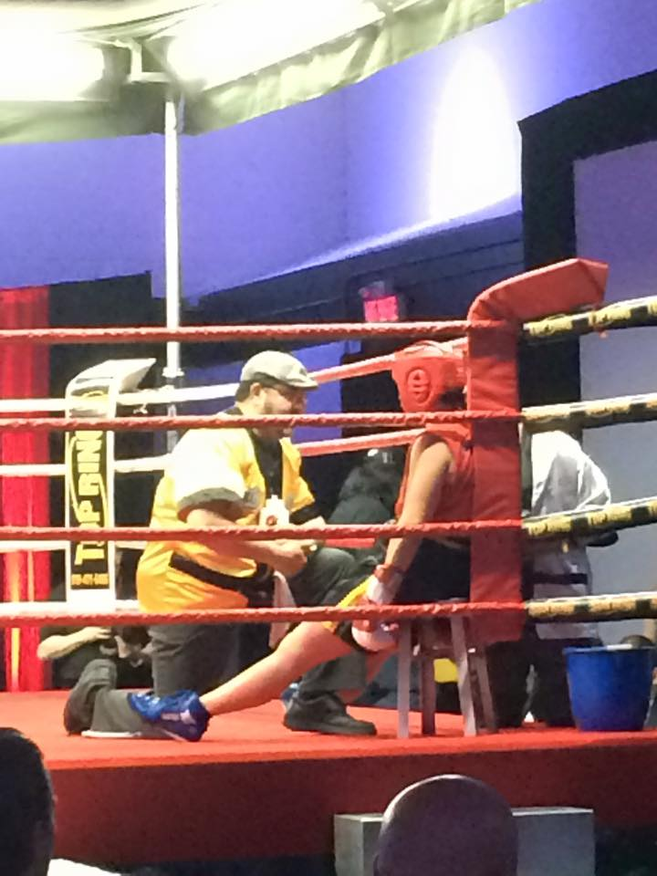
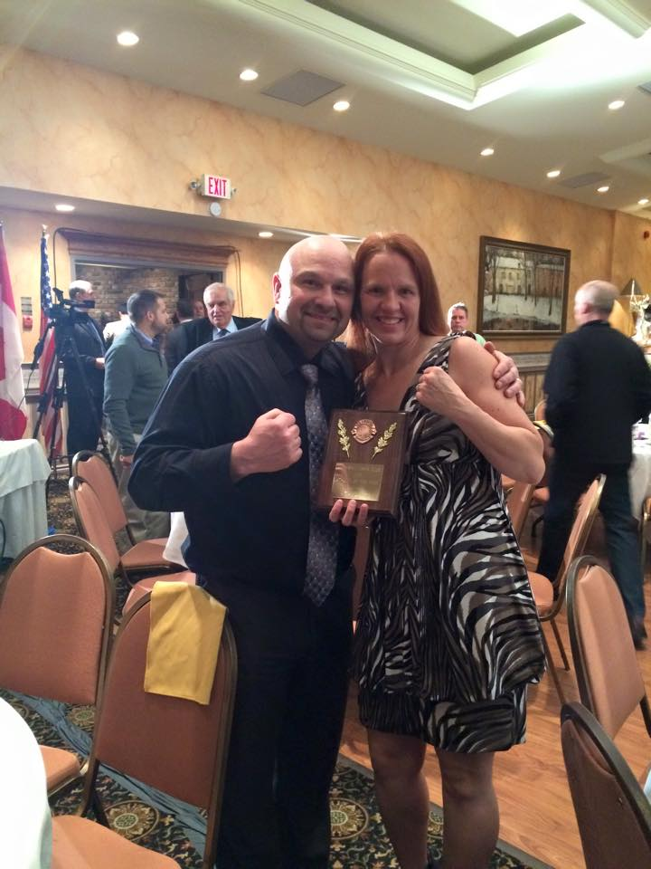
My Passion…..

Slide 8
“Never go to a Doctor whose office plants have died.” -Erma Bombeck

Slide 9
Fountaingate – Ladies Only Fitness Classes *Energized with Chantel*

Slide 10
“Do you not know that your bodies are temples of the Holy Spirit who is in you, whom you have received from God? You are not your own.” – 1 Corinthians 6:19

Slide 11
II. Emotional & Relational Health

Slide 12
a) Emotional Health

Slide 13
1. PRAY
“This is the confidence we have in approaching God: That if we ask anything according to His will, He hears us.
-1 John 5:14

Slide 14
2. READ YOUR BIBLE
“I have told you these things, so that in me you may have peace. In this world you will have trouble. But take Heart! I have overcome the World.”
-John 16:33

Slide 15
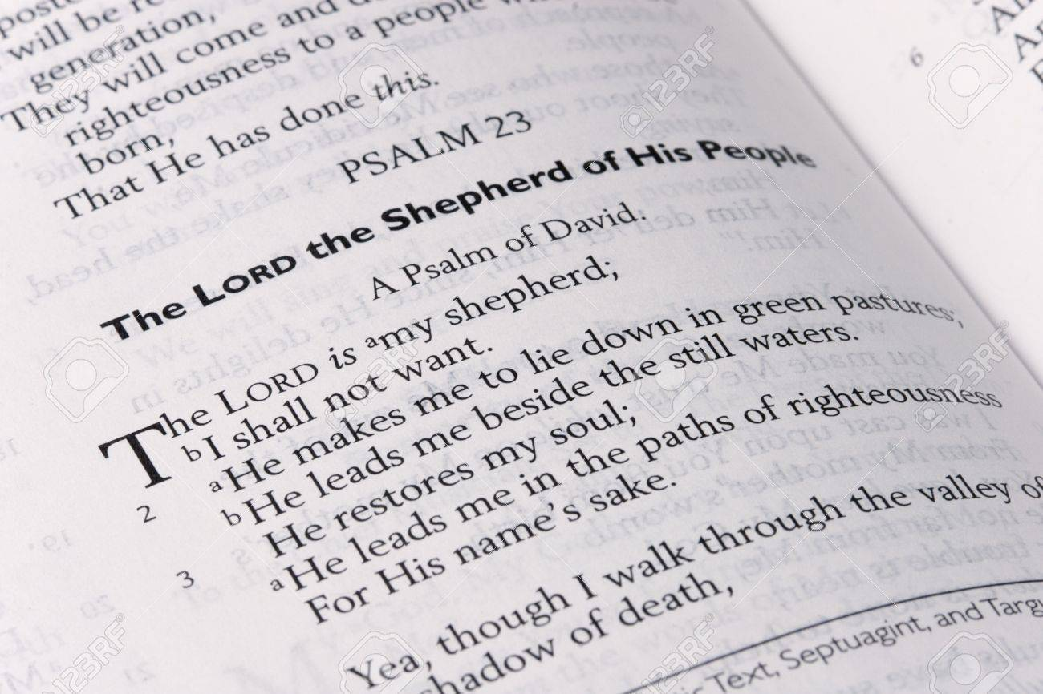
The Bible teaches us….

Slide 16
3. JOURNAL
“On that night the king could not sleep. And he gave orders to bring the book of memorable deeds, the chronicles, and they were read before the king.”
-Esther 6:1

Slide 17
4. REST
“By the seventh day God had finished the work He had been doing; on the seventh day He rested from all His work.”
-Genesis 2:2

Slide 18
5. SEEK PROFESSIONAL HELP
“For lack of guidance a nation falls, but victory is won through many advisors.”
-Proverbs 11:14

Slide 19
Fountaingate will gently walk you through your struggles, as Jesus did.

Slide 20
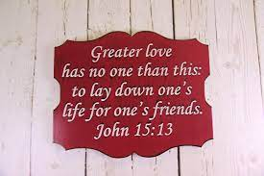
b) Relational Health

Slide 22
The Importance of Our Words

Slide 23
III. Financial Health

Slide 26
IV. CAREER/COMMUNITY HEALTH

Slide 27
1. CAREER HEALTH
“For I know the Plans that I have for you,” declares the Lord, “plans for welfare and not for calamity to give you a future and a hope.”
-Jeremiah 29:11

Slide 28
2. Community Health
“Share each other’s burdens, and in this way obey the law of Christ.”
-Galatians 6:2-12

Slide 29
V. SPIRITUAL HEALTH

Slide 30
Diagnosing your Spiritual Health….

Slide 31
Mission Statement:
Gently offering Healing, Health and Hope in a Hurting World

Slide 32
JOSHUA GRANT
Then…

Slide 33
JOSHUA GRANT
Now!!!

