Slide 1
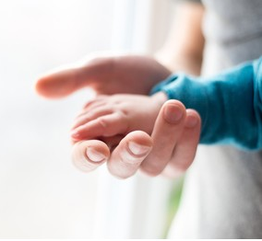
The Mission of Fountaingate –Part III
Gently Offering . . . Hope in a Hurting World

Slide 2
Mission Statement:
Gently offering Healing, Health and Hope in a Hurting World

Slide 3
There are only two kinds of hope. A true hope and a false hope. Each carry with them a reward.

Slide 4
I. THE REWARD OF FALSE HOPE
“Thus says the LORD: cursed [with great evil] is the strong man who trusts and relies on frail man, making weak [human] flesh his arm, and whose mind and heart turns aside from the Lord.”
Jeremiah 17: 5 AMP
A. A Curse for Turning Away from God

Slide 5
I. THE REWARD OF FALSE HOPE
“He will be like a bush in the wastelands; he will not see prosperity when it comes. He will dwell in the parched places of the desert, in the salt land where no one lives.”
Jeremiah 17: 6
B. A Lack of Prosperity

Slide 6
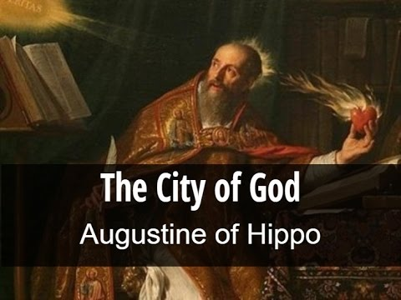
I. THE REWARD OF FALSE HOPE
“The world has been controlled by two parties; those who have governed by ‘love of self to the point of contempt for God’ and those who are governed by ‘love of God to the
point of
contempt
for self. ’”
B. A Lack of Prosperity

Slide 7
II. THE REWARDS OF TRUE HOPE A. A Blessing for Turning to God

Slide 8
II. THE REWARDS OF TRUE HOPE A. A Blessing for Turning to God 1. It Makes us Not Ashamed

Slide 9
II. THE REWARDS OF TRUE HOPE A. A Blessing for Turning to God 1. It Makes us Not Ashamed

Slide 10
II. THE REWARDS OF TRUE HOPE A. A Blessing for Turning to God 1. It Makes us Not Ashamed
“Why is my pain unending and my wound grievous and incurable? Will you be like a deceptive brook, like a spring that fails?
19. Therefore this is what the Lord says, ‘If you repent, I will restore you that you may serve me; if you utter worthy, not worthless, words, you’ll be my spokesman. Let this people turn to you (as God’s spokesman) but you must not turn to them.”
Jeremiah 15:18,19

Slide 11
II. THE REWARDS OF TRUE HOPE A. A Blessing for Turning to God 2. It Offers an Abundance of Prosperity
“He will be like a tree planted by the water that sends out its roots by the stream. It does not fear when heat comes; its leaves are always green. It has no worries in the year of drought and never fails to bear fruit.”
Jeremiah 17:8
“

Slide 12
II. THE REWARDS OF TRUE HOPE A. A Blessing for Turning to God 2. It Offers an Abundance of Prosperity
“Yet this I called to mind and therefore I have hope:
22. Because of the LORD’s great love we are not consumed, for his compassions never fail.
23. They are new every morning; great is your faithfulness.
24. I say to myself, ‘The Lord is my portion; therefore I will wait [hope in -- KJV] for him.”
Lamentations 3:21 – 24
“

Slide 13
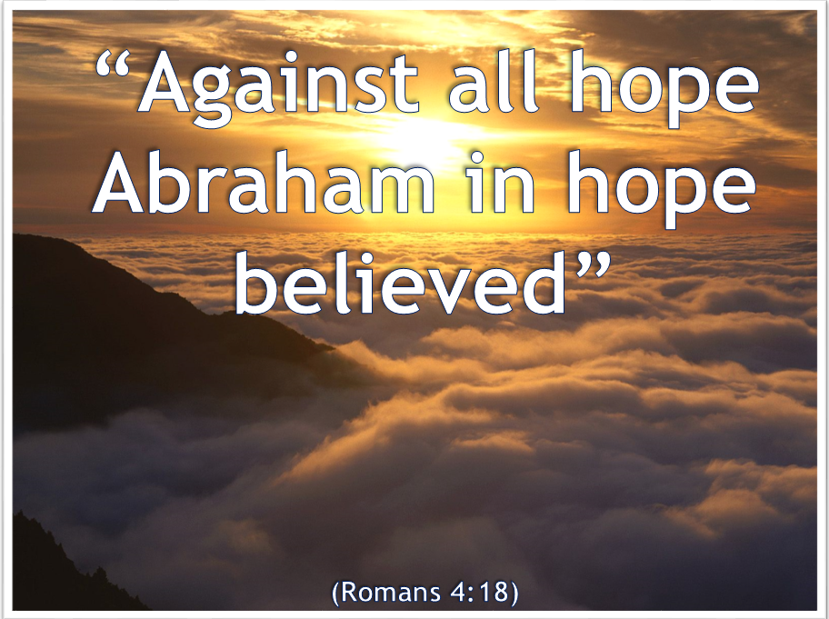
II. THE REWARDS OF TRUE HOPE B. A Confidence for Turning to God 1. A Hope Against all Hope
“

Slide 14
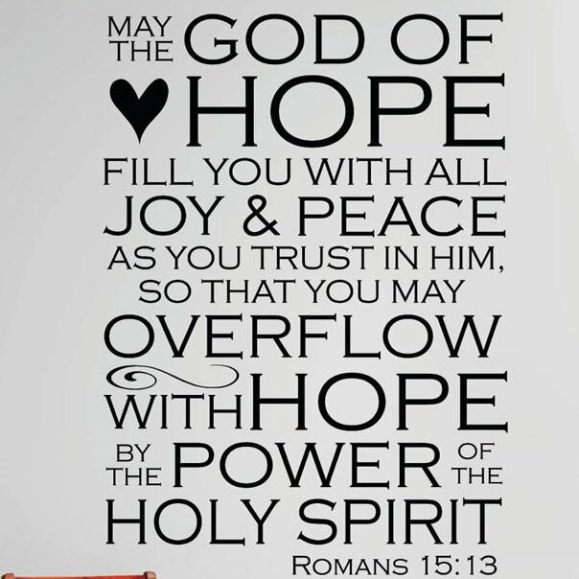
II. THE REWARDS OF TRUE HOPE B. A Confidence for Turning to God 2. Joy, Peace and Trust
“

