Slide 1
The Power of His Touch
Matthew 8:1-4

Slide 2
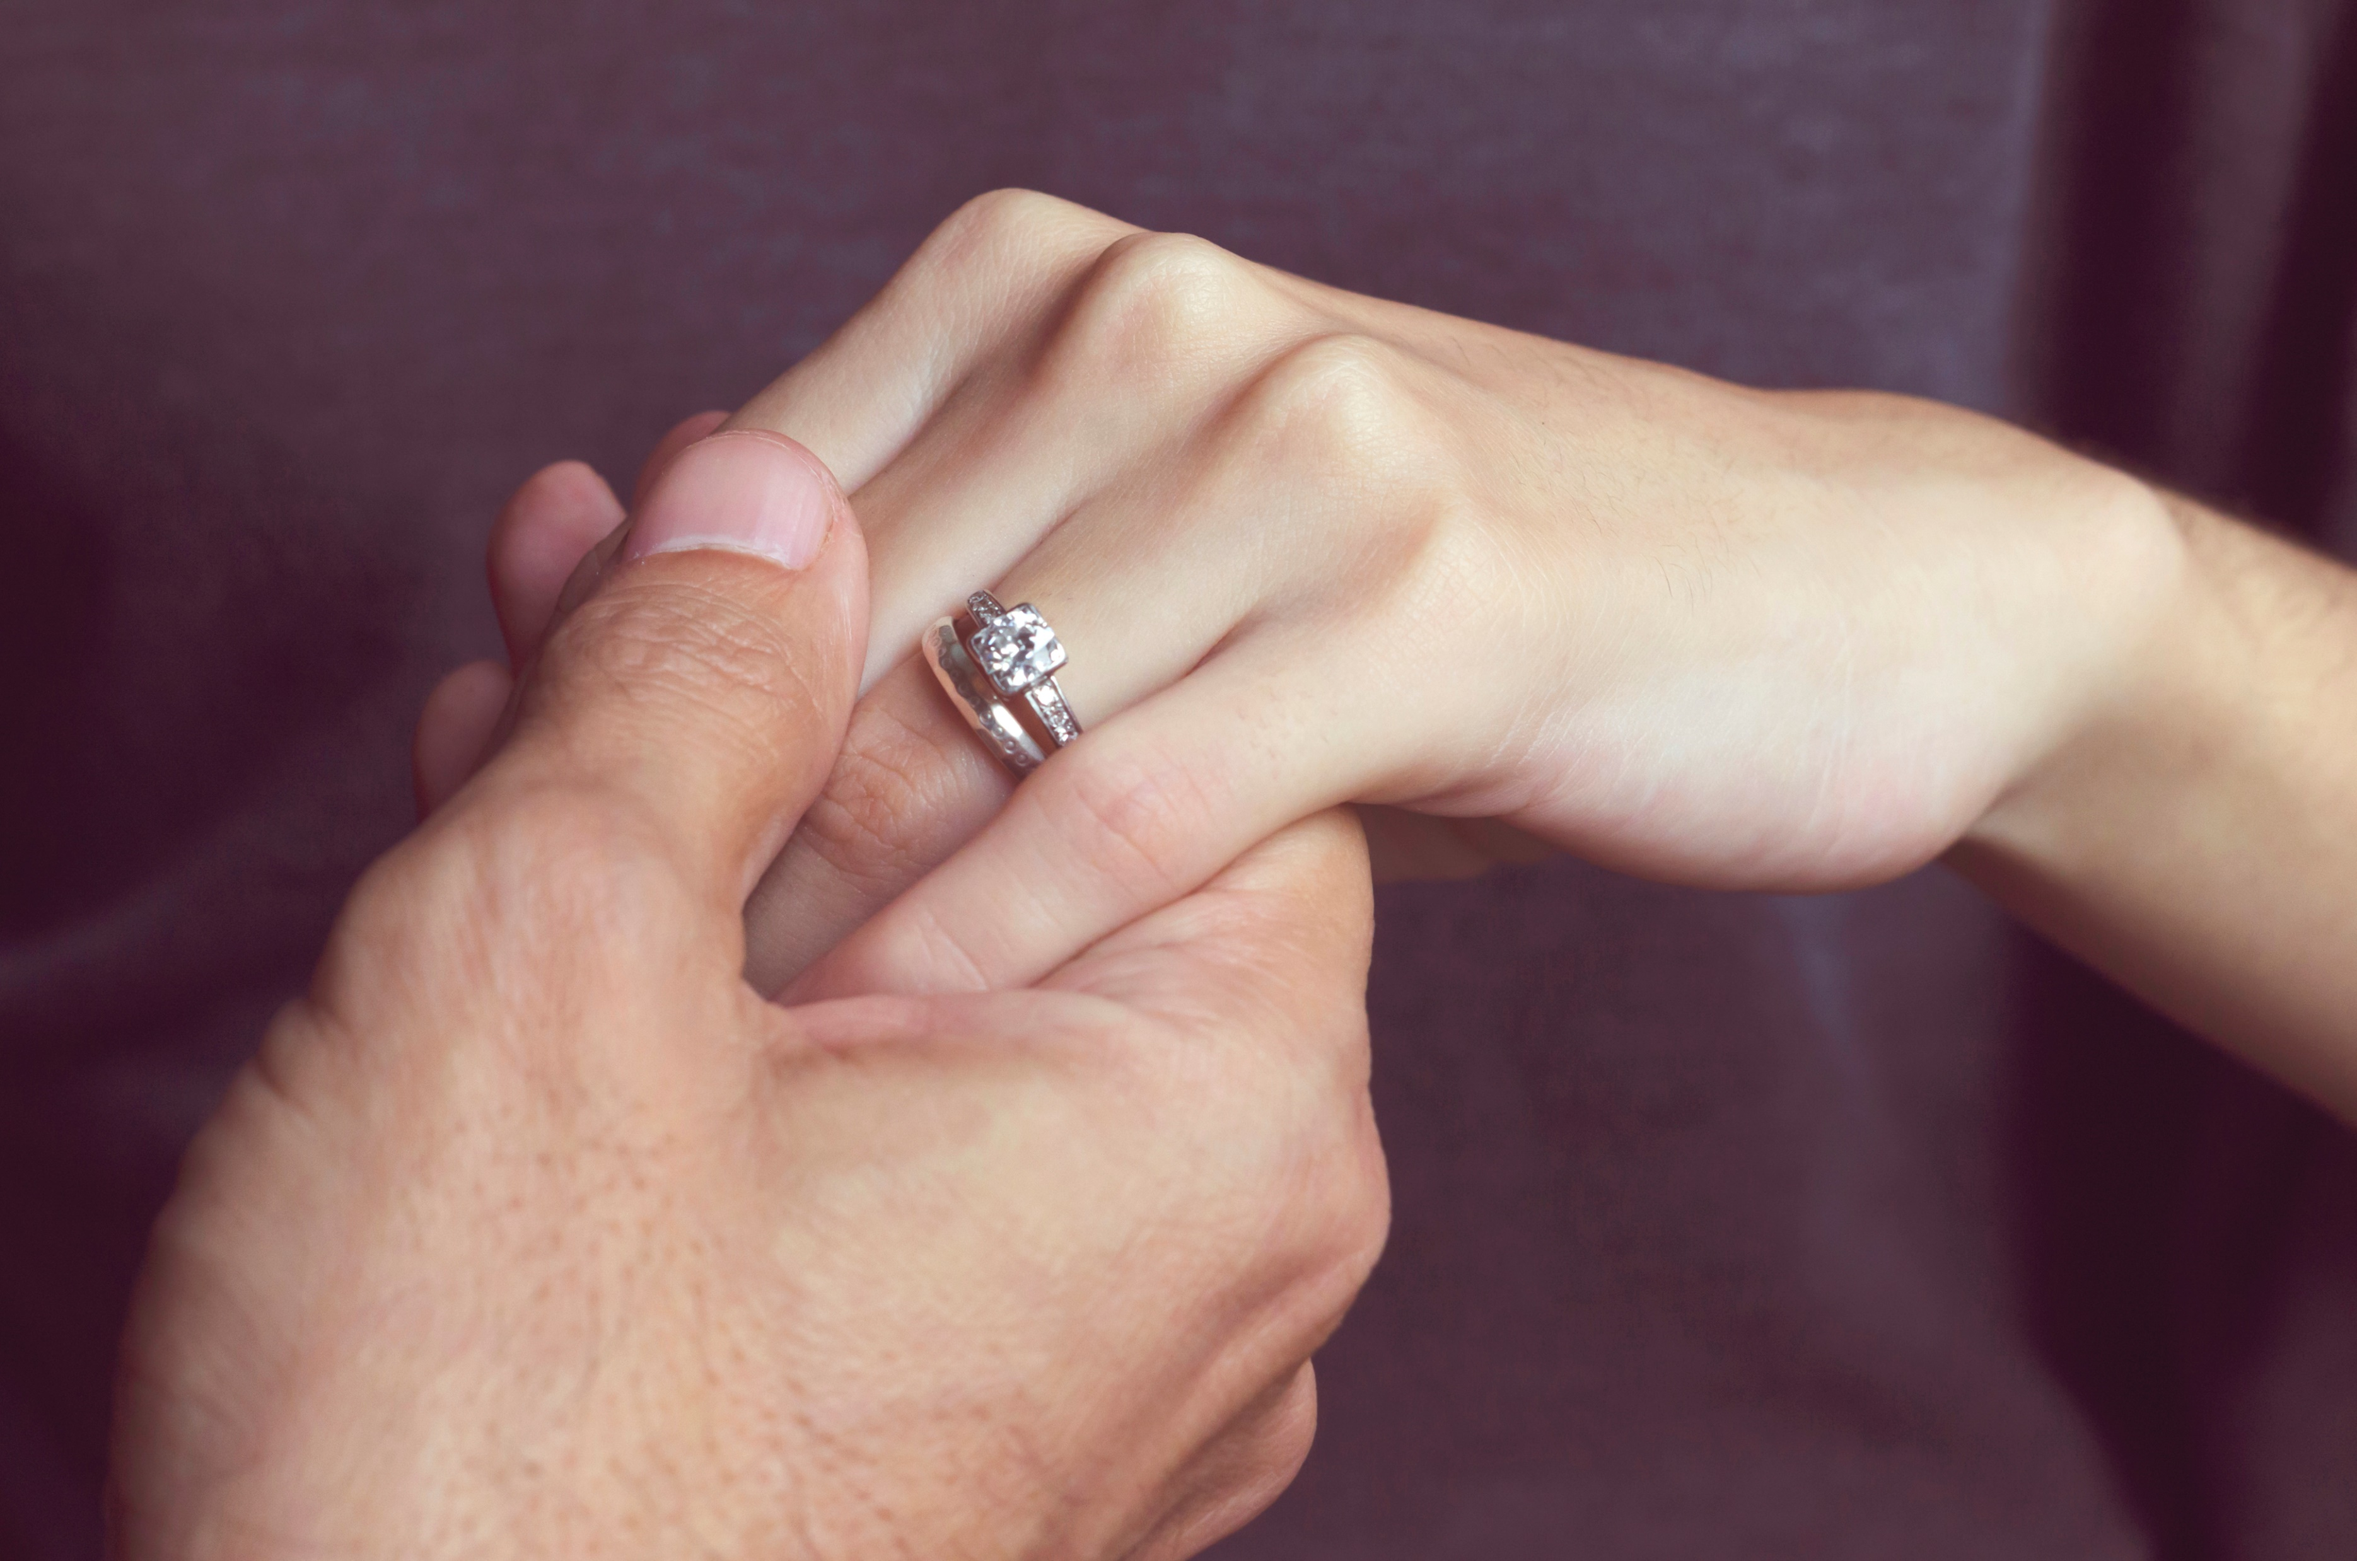
Humans have 5 senses…..

Slide 3
His touch is Intimate, Powerful & Transforming

Slide 4
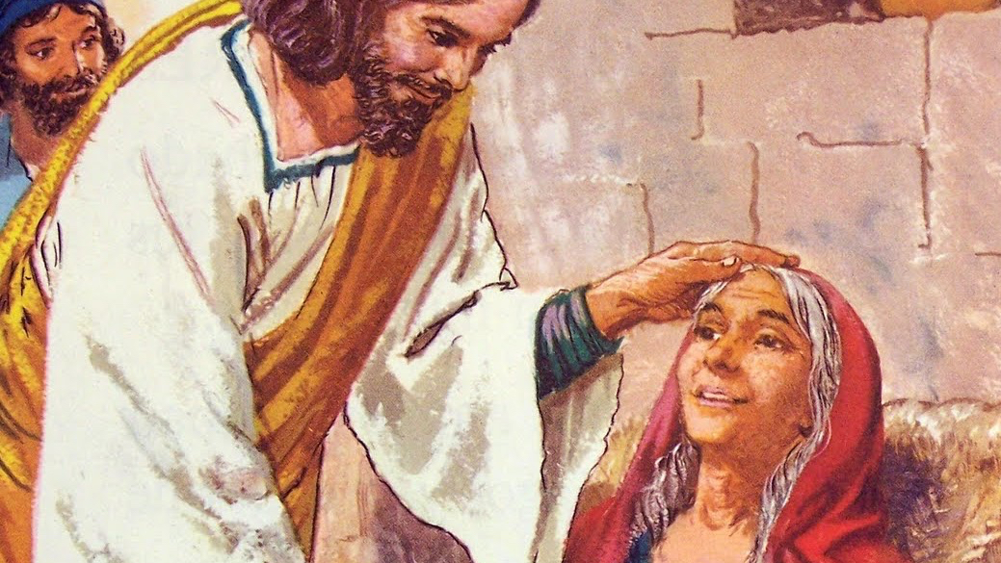
I. IT TRANSFORMS THE DISEASED
“HE TOUCHED HER HAND, AND THE FEVER LEFT HER, AND SHE GOT UP AND BEGAN TO WAIT ON HIM”
Matthew 8:15

Slide 5
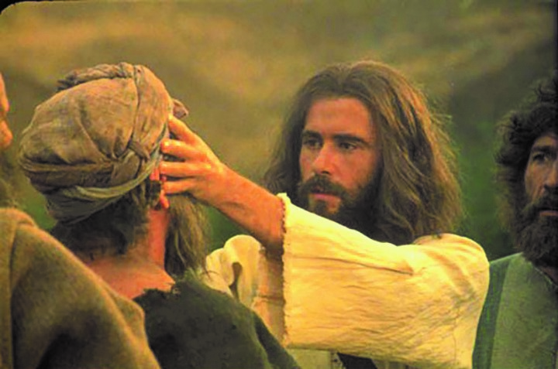
II. IT TRANSFORMS THE DEAF
“AFTER HE TOOK HIM ASIDE, AWAY FROM THE CROWD, JESUS PUT HIS FINGERS INTO THE MAN’S EARS. THEN HE SPIT AND TOUCHED THE MAN’S TONGUE.”
Mark 7:33

Slide 6
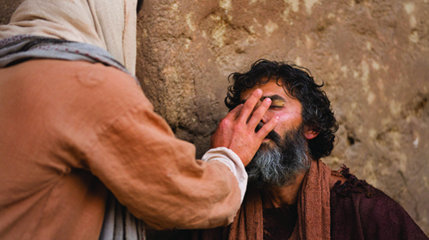
III. IT TRANSFORMS THE DARKENED
“THEN HE TOUCHED THEIR EYES AND SAID, “ACCORDING TO YOUR FAITH, LET IT BE DONE TO YOU.”
Matthew 9:29

Slide 7
IV. IT TRANSFORMS THE DOOMED

Slide 8
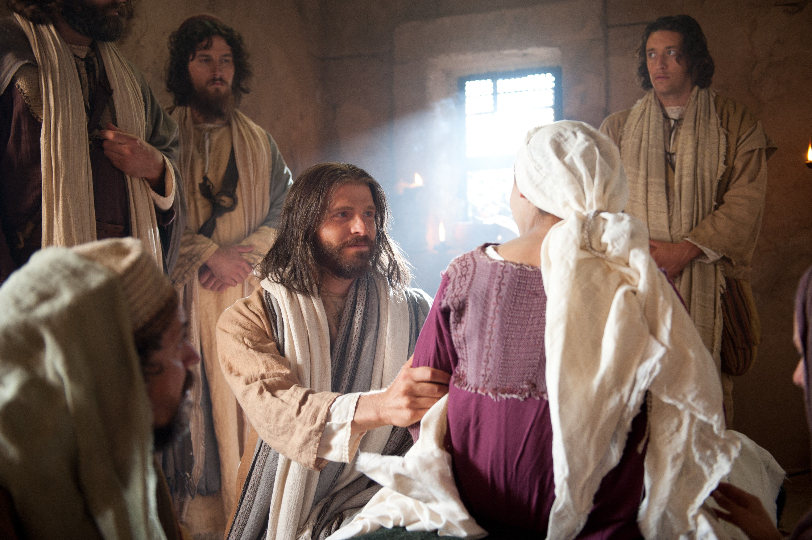
V. IT TRANSFORMS THE DEAD
“BUT HE TOOK HER BY THE HAND AND SAID, “MY CHILD, GET UP!”
Luke 8:54

Slide 9
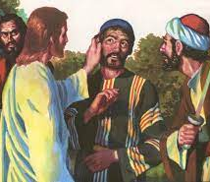
VI. IT TRANSFORMS THE DECEIVED
BUT JESUS ANSWERED, “NO MORE OF THIS!” AND HE TOUCHED THE MAN’S EAR AND HEALED HIM.
Luke 22:51

Slide 10
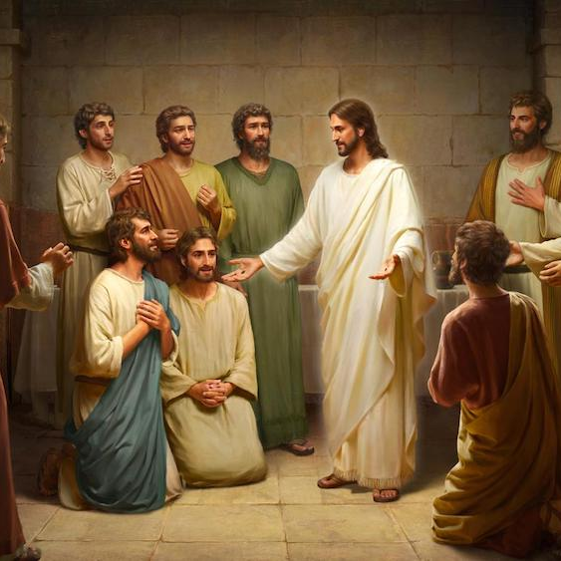
VII. IT TRANSFORMS THE DISMAYED
BUT JESUS CAME AND TOUCHED THEM. “GET UP” HE SAID, “DON’T BE AFRAID.”
Matthew 17:7

Slide 11
HAVE YOU FELT THE POWER OF HIS TOUCH?

