Slide 1
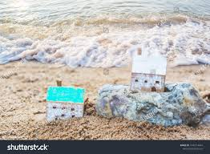
The Rock Star
Matthew 7:24-27

Slide 2
“Therefore everyone who hears these words of mine and puts them into practice is like a wise man who built his house on the rock. The rain came down, the streams rose, and the winds blew and beat against that house; yet it did not fall, because it had its foundation on the rock.

Slide 3
But everyone who hears these words of mine and does not put them into practice is like a foolish man who built his house on sand. The rain came down, the streams rose, and the winds blew and beat against that house, and it fell with a great crash.” Matthew 7:24-27

Slide 4
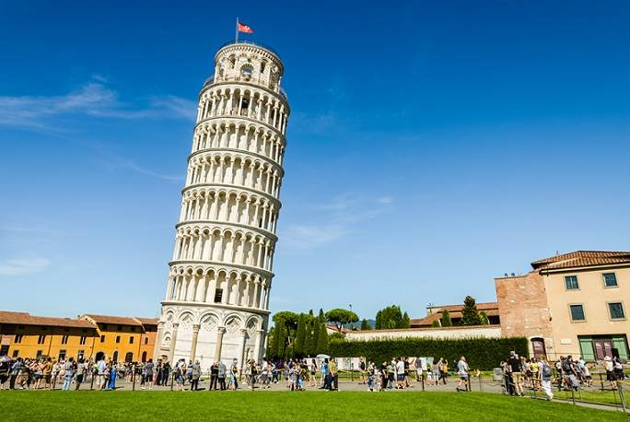
Leaning Tower of Pisa “Marshy Land”

Slide 5
I. CONSIDER THE COMPARISONS
A) BOTH HEARD
THE
WORDS OF CHRIST

Slide 6
I. CONSIDER THE COMPARISONS
B) BOTH BUILT
HOUSES

Slide 7
I. CONSIDER THE COMPARISONS
C) BOTH BUILT IN SAME LOCATION
D) BOTH BUILT SIMILAR HOMES

Slide 8
“For what I received I passed on to you as of first importance: that Christ died for our sins according to the Scriptures, that he was buried, that he was raised on the third day according to the Scriptures,” 1 Corinthians 15:3–4 NIV

Slide 9
“If you declare with your mouth, “Jesus is Lord,” and believe in your heart that God raised him from the dead, you will be saved.” Romans 10:9 NIV

Slide 10
II. CONSIDER THE CONTRASTS
ONE MAN BUILT HIS HOUSE ON THE SAND

Slide 11
“As they were walking along the road, a man said to him, “I will follow you wherever you go.” Jesus replied, “Foxes have dens and birds have nests, but the Son of Man has no place to lay his head.” He said to another man, “Follow me.” But he replied, “Lord, first let me go and bury my father.” Jesus said to him, “Let the dead bury their own dead, but you go and proclaim the kingdom of God.”

Slide 12
Still another said, “I will follow you, Lord; but first let me go back and say goodbye to my family.” Jesus replied, “No one who puts a hand to the plow and looks back is fit for service in the kingdom of God.” Luke 9:57–62 NIV

Slide 13
II. CONSIDER THE CONTRASTS
B) ONE MAN BUILT HIS HOUSE ON THE ROCK

Slide 14
“ Simon Peter answered, “You are the Messiah, the Son of the living God.” Jesus replied, “Blessed are you, Simon son of Jonah, for this was not revealed to you by flesh and blood, but by my Father in heaven. And I tell you that you are Peter, and on this rock I will build my church, and the gates of Hades will not overcome it.” Matthew 16:16-18 NIV

Slide 15
“We know that we have come to know Him if we keep His commands. Whoever says, “I know Him,” but does not do what He commands is a liar, and the truth is not in that person. But if anyone obeys His word, love for God is truly made complete in them. This is how we know we are in Him: Whoever claims to live in Him must live as Jesus did.” 1 John 2:3–6 NIV

Slide 16
III. CONSIDER THE CONSEQUENCES

Slide 17
There is a storm coming, and your house is right in its path.

