Slide 1
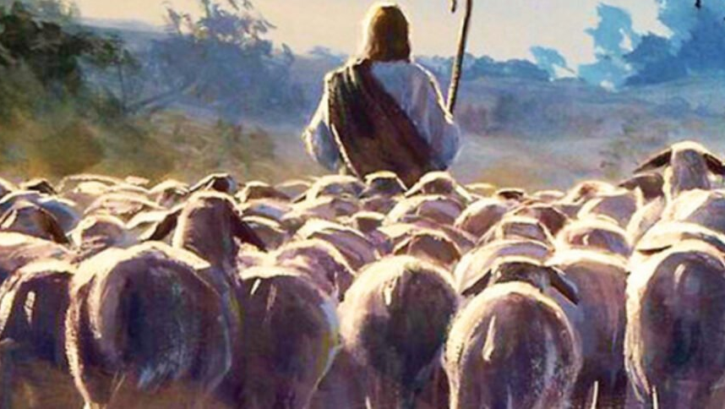
The Shepherd of My Soul
Psalms 23

Slide 2
Psalms 23

Slide 3
Psalms 23:2-3 “He makes me lie down in green pastures. He leads me beside still waters. He restores my soul.”

Slide 4
1. He Provides Places of Rest For My Soul

Slide 5
#1 – Look Back #2 -Look Around #3 – Look Ahead #4 – Look Up

Slide 6
Sabbath Rest
Worship Together
Word Of God
Minister in Your Giftedness
Fellowship

Slide 7
2. He Leads Me Along Places of Refreshment

Slide 8
3. He Restores My Soul

