Slide 1
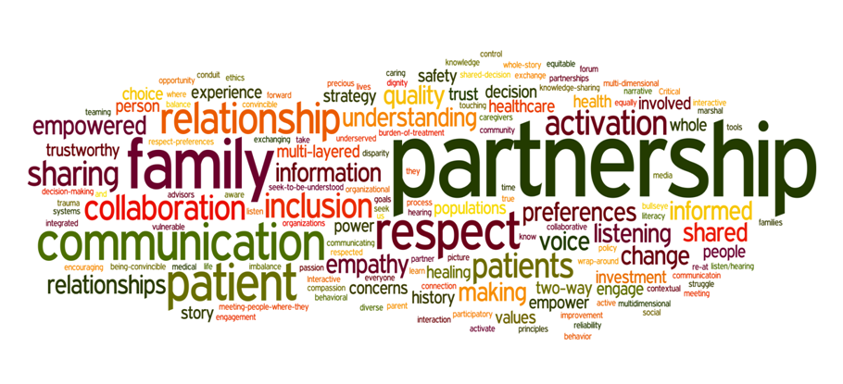
TRANSFORMATIONAL CHANGES
Matthew 5: 21-26

Slide 2
How can we develop quality transformations that will advance the kingdom of god?

Slide 3
i. We need to be respectful of others (Matthew 5:21-24)
Matthew 5:22b
Psalm 14:1

Slide 4
II. We need to be reconciled to others (Matthew 5:23-24)
When Jesus had finished saying these things, the crowds were amazed at his teachings,
29. Because he taught as one who had authority, and not as their teachers of the law. Matthew 7:28,29

Slide 5
There was no place for a half-hearted sacrifice. The worshiper could never . . . 1). Worship quickly and then make things right 2). Thank God that he was in the temple without having to deal with the broken relationship. 3). Try to insinuate that everything was right when in fact, it wasn’t.

Slide 6
There was only a place for a full-hearted sacrifice. The worshiper could . . . 1). Worship slowly once everything was right with God and man 2). Thank God that he was able to reconcile with his brother. 3). Enter with a sincere heart before God.

Slide 7
III. WE NEED TO BE REASONABLE WITH OTHERS (Matthew 5:25,26)

