Slide 1
UNDERSTANDING GOD AND HIS PURPOSE IN OUR LIVES
Text: Hebrews 11:6

Slide 2
UNDERSTANDING GOD AND HIS PURPOSE IN OUR LIVES
“And without faith it is impossible to please God, because anyone who comes to him must believe that he exists and that he rewards those who earnestly seek him.”
Hebrews 11:6

Slide 3
I. GOD GIVES LIFE TO OUR BODY
“then the Lord God formed [that is, created the body of] man from the dust of the ground, and breathed into his nostrils the breath of life; and the man became a living being [an individual complete in body and spirit].
Genesis 2:7 AMP

Slide 4
I. GOD GIVES LIFE TO OUR BODY
“And Jehovah God formed man of the dust of the ground, and breathed into his nostrils the breath of life; and man became a living soul.”
Genesis 2:7 ASV

Slide 5
I. GOD GIVES LIFE TO OUR BODY
“For as the body apart from the spirit is dead, so also faith apart from works is dead."
James 2:26, ESV

Slide 6
I. GOD GIVES LIFE TO OUR BODY
“When Elizabeth heard Mary’s greeting, the baby leaped in her womb, and Elizabeth was filled with the Holy Spirit.”
Luke 1:41

Slide 7
I. GOD GIVES LIFE TO OUR BODY
“And it came to pass, that, when Elisabeth heard the salutation of Mary, the babe {o} leaped in her womb; and Elisabeth was filled with the Holy Ghost:”
{o} “This was no ordinary or usual type of moving.”
Geneva Study Bible
Luke 1:41 footnote

Slide 8
II. GOD GIVES LIBERTY TO OUR SOUL
“Here I am! I stand at the door and knock. If anyone hears my voice and opens the door, I will come in and eat with that person, and they with me.”
Revelation 3:20

Slide 9
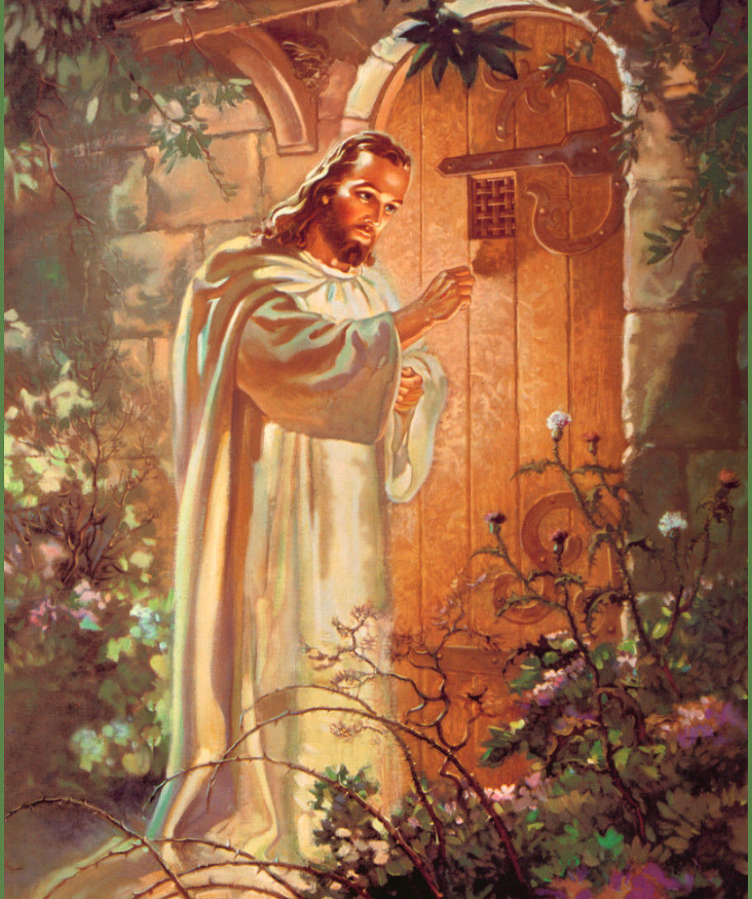
II. GOD GIVES LIBERTY TO OUR SOUL
William Holman Hunt
and later by Warner Sallman

Slide 10
II. GOD GIVES LIBERTY TO OUR SOUL
“For the Son of man came to seek and to save what was lost.”
Luke 19:10

Slide 11
II. GOD GIVES LIBERTY TO OUR SOUL
“Tell her to help me!”
Luke 10:40

Slide 12
II. GOD GIVES LIBERTY TO OUR SOUL
“But the Lord answered and said to her, “Martha, Martha, you are worried and bothered about so many things;
42. but only one thing is necessary, for Mary has chosen the good part, which shall not be taken away from her.”
Luke 10:41,42

Slide 13
II. GOD GIVES LIBERTY TO OUR SOUL
The name “Martha” comes from an Aramaic word meaning “lady or mistress.” It is not really a proper name but rather a title.

