Slide 1
UNDERSTANDING OUR TIMES
Text: I Chronicles 12:32

Slide 2
UNDERSTANDING OUR TIMES
"Issachar is a rawboned (strong) donkey lying down between two saddlebags.
15. When he sees how good is his resting place and how pleasant is his land, he will bend his shoulder to the burden and submit to forced labour.“
Genesis 49:14

Slide 3
Lets Study Biblical History as Well as the Facts of Our Time in Order to Help Us Understand the Direction We Should Take Now and in the Future.

Slide 4
I. DECISIVENESS FOR O.T. ISRAEL
"The princes of Issachar were with Deborah; yes, Issachar was with Barak, rushing after him into the valley. In the districts of Reuben there was much searching of heart."
Judges 5:15

Slide 5
I. DECISIVENESS FOR O.T. ISRAEL
"They came to Hebron fully determined to make David king over all Israel."
I Chronicles 12:38b

Slide 6
I. DECISIVENESS FOR O.T. ISRAEL
"Also, their neighbors from as far away as Issachar, Zebulun and Naphtali came bringing food on donkeys, camels, mules and oxen. There were plentiful supplies of flour, fig cakes, raisin cakes, wine, oil, cattle and sheep, for there was joy in Israel."
I Chronicles 12:40

Slide 7
II. DECISIVENESS FOR N.T. ISRAEL
"While Paul was waiting for them (Silas and Timothy) in Athens, he was greatly distressed to see that the city was full of idols."
Acts 17:16

Slide 8
II. DECISIVENESS FOR N.T. ISRAEL
"Paul then stood up in the meeting of Areopagus [he knew where to be] and said [he knew what to say]: 'Men of Athens! I see that in every way you are very religious [he knew the right approach to take].
Acts 17:22

Slide 9
II. DECISIVENESS FOR N.T. ISRAEL
"For as I walked around and looked carefully at your objects of worship, [he knew what to see], I even found an altar with this inscription: TO AN UNKNOWN GOD. Now what you worship as something unknown I am going to proclaim to you."
Acts 17:23

Slide 10
II. DECISIVENESS FOR N.T. ISRAEL
"Everyone who competes in the games goes into strict training. They do it to get a crown that will not last; but we do it to get a crown that will last forever."
I Corinthians 9:25

Slide 11
III. DECISIVENESS FOR THE LAST DAYS CHURCH
What Is Important to Know to Reach Our World?
A. Age Level -
B. New Trends -
C. Materialism -
D. Knowledge -

Slide 12
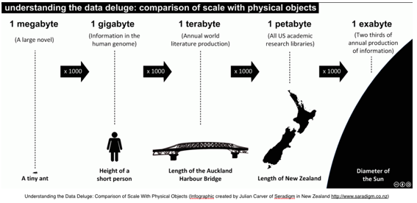

Slide 13
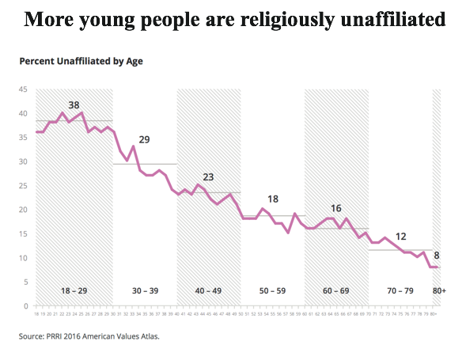

Slide 14
III. DECISIVENESS FOR THE LAST DAYS CHURCH
What Is Important to Know to Reach Our World?
D. Knowledge –
1. Don’t let fear control you - I Samuel 16:7; II Timothy 1:7

Slide 15
III. DECISIVENESS FOR THE LAST DAYS CHURCH
What Is Important to Know to Reach Our World?
D. Knowledge –
2. Don’t Believe all the experts. Search and compare - I Peter 1:25

Slide 16
III. DECISIVENESS FOR THE LAST DAYS CHURCH
What Is Important to Know to Reach Our World?
D. Knowledge –
3. Avoid globalism - Revelation 13

Slide 17
III. DECISIVENESS FOR THE LAST DAYS CHURCH
What Is Important to Know to Reach Our World?
D. Knowledge –
4. Stand strong for life and liberty - Galatians 5:1

Slide 18
III. DECISIVENESS FOR THE LAST DAYS CHURCH
What Is Important to Know to Reach Our World?
D. Knowledge –
5. Be Cautious using social media - Psalm 85:8

Slide 19
III. DECISIVENESS FOR THE LAST DAYS CHURCH
What Is Important to Know to Reach Our World?
D. Knowledge –
6. Keep yourself healthy - Body, Soul and Spirit - I Corinthians 10:31

Slide 20
III. DECISIVENESS FOR THE LAST DAYS CHURCH
What Is Important to Know to Reach Our World?
D. Knowledge –
7. Test Everything by God’s Word - I Thessalonians 5:21

