Slide 2
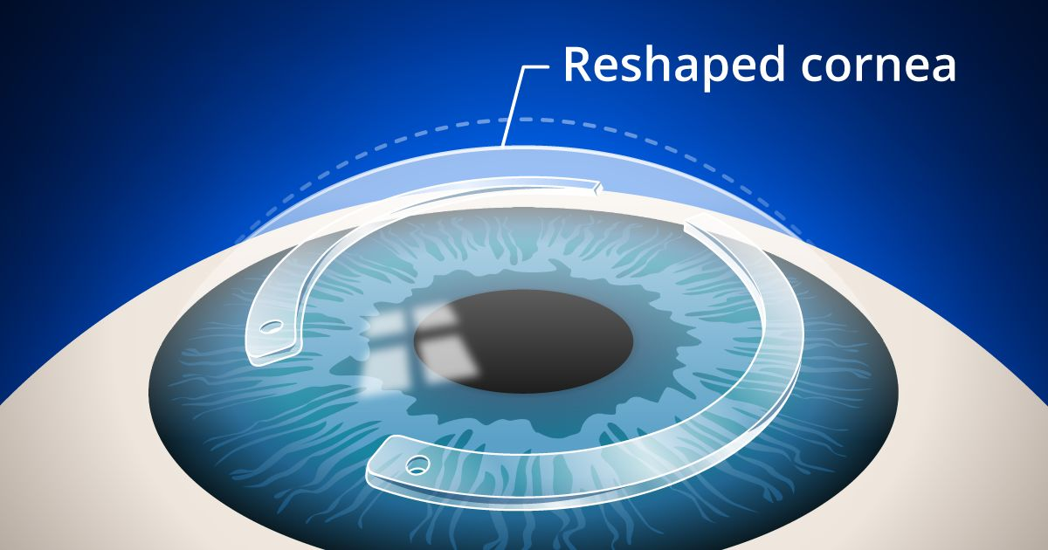

Slide 3
Jesus once said, “But blessed are your eyes because they see, and your ears because they hear.” Matthew 13:16

Slide 4
"And the seventh angel sounded; and there were great voices in heaven, saying, The kingdoms of this world are become the kingdoms of our Lord, and of his Christ; and he shall reign for ever and ever." Revelation 11:15 - KJV

Slide 5
“The kingdom of the world has become the kingdom of our Lord and of his Messiah, Revelation 11:15 - NIV

Slide 6
“Therefore, since we are receiving a kingdom that cannot be shaken, let us be thankful, and so worship God acceptably with reverence and awe,” Hebrews 12:28

Slide 7
“Yet once more I shake not the earth only, but also heaven. 27. And this word, Yet once more, signifieth the removing of those things that are shaken, as of things that are made, that those things which cannot be shaken may remain.” Hebrews 12:26-27 KJV

Slide 8
1. The Financial Kingdom –
“Then I heard what sounded like a voice among the four living creatures, saying, “Two pounds of wheat for a day’s wages, and six pounds of barley for a day’s wages, and do not damage the oil and the wine!”
Revelation 6:6

Slide 9
1. The Financial Kingdom –

Slide 10
2. The Medical Kingdom –
”There will be great earthquakes, famines and pestilences in various places, and fearful events and great signs from heaven.”
Luke 21:11

Slide 11
3. The Educational Kingdom
4. The Geographical Kingdom

Slide 12
5. The Judicial Kingdom –
“Woe to those who call evil good and good evil, who put darkness for light and light for darkness, who put bitter for sweet and sweet for bitter.”
Isaiah 5:20

Slide 13
6. The Political Kingdom
7. The Travel Kingdom
8. The Supply & Demand Kingdom
9. The Military & Police Protection Kingdom
10. The Media Kingdom

