Slide 1
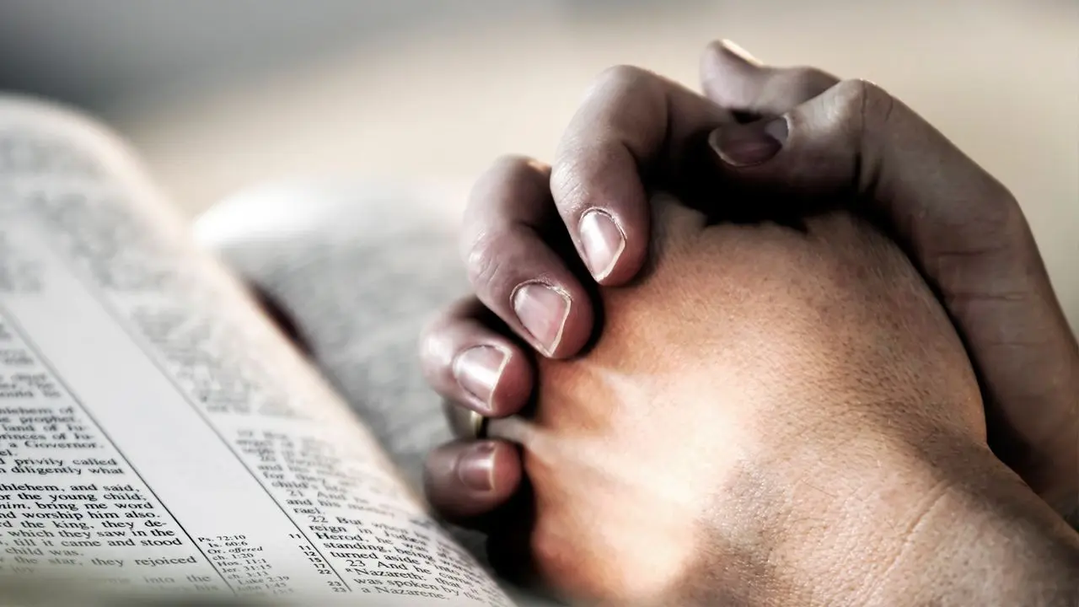
Victorious Prayer Life
James 4:1-10

Slide 2
I. AVOID FORSAKEN PRAYING
“REJOICE ALWAYS, PRAY CONTINUALLY, GIVE THANKS IN ALL CIRCUMSTANCES;
FOR THIS IS GOD’S WILL FOR YOU IN CHRIST JESUS.”
1 THESSALONIANS 5:16-18

Slide 3
II. AVOID FOOLISH PRAYING
“THE LORD DETESTS THE SACRIFICE OF THE WICKED, BUT THE PRAYER OF THE UPRIGHT PLEASES HIM.”
PROVERBS 15:8

Slide 4
III. ADOPT FAITHFUL PRAYING
BE SENSITIVE
“In the same way, the Spirit helps us in our weakness. We do not know what we ought to pray for, but the Spirit himself intercedes for us through wordless groans. And he who searches our hearts knows the mind of the Spirit, because the Spirit intercedes for God’s people in accordance with the will of God.”
Romans 8:26-27

Slide 5
III. ADOPT FAITHFUL PRAYING
B) BE SUBMISSIVE
“He said to them,
“When you pray, say:
“Father, hallowed be your name, your kingdom come.”
Luke 11:2

Slide 6
III. ADOPT FAITHFUL PRAYING
C) BE STEADFAST
EPHESIANS 6:10-20

Slide 7
III. ADOPT FAITHFUL PRAYING
D) BE SEPARATED
Psalms 66:18
Matthew 6:24
1 Chronicles 7:14

Slide 8
III. ADOPT FAITHFUL PRAYING
D) BE SINCERE

Slide 9
HOW’S YOUR PRAYER LIFE?
COME TO THE ALTAR!

