Slide 1
WHAT’S YOUR BACKUP PLAN?
Text: Joel 2:30-31

Slide 2
“Nation will rise against nation, and kingdom against kingdom.
11. There will be great earthquakes, famines and pestilences in various places, and fearful events and great signs from heaven . . .
25. There will be signs in the sun, moon and stars. On the earth, nations will be in anguish and perplexity at the roaring and tossing of the sea.
26. People will faint from terror, apprehensive of what is coming on the world, for the heavenly bodies will be shaken.
27. At that time they will see the Son of Man coming in a cloud with power and great glory.
28. When these things begin to take place, stand up and lift up your heads, because your redemption is drawing near.
Luke 21:10,11,25-28

Slide 3
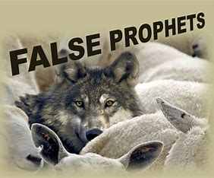
“Therefore,” declares the Lord, “I am against the prophets who steal from one another words supposedly from me.”
Jeremiah 23:30

Slide 4
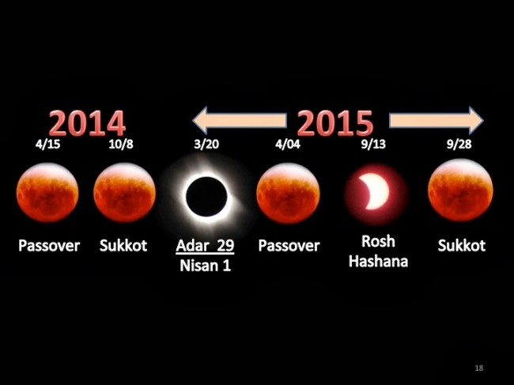

Slide 5
“I will show wonders in the heavens and on the earth, blood and fire and billows of smoke.
31. The sun will be turned to darkness, and the moon to blood, before the coming of the great and dreadful day of the LORD.”
Joel 2:30,31

Slide 6
And God said, “Let there be lights in the vault of the sky to separate the day from the night, and let them serve as signs to mark sacred times, and days and years.”
Genesis 1:14

Slide 7
“A wicked and adulterous generation asks for a sign! But none will be given it except the sign of the prophet Jonah.
40. For as Jonah was three days and three nights in the belly of a huge fish, so the Son of Man will be three days and three nights in the heart of the earth.”
Matthew 12:39,40

Slide 8
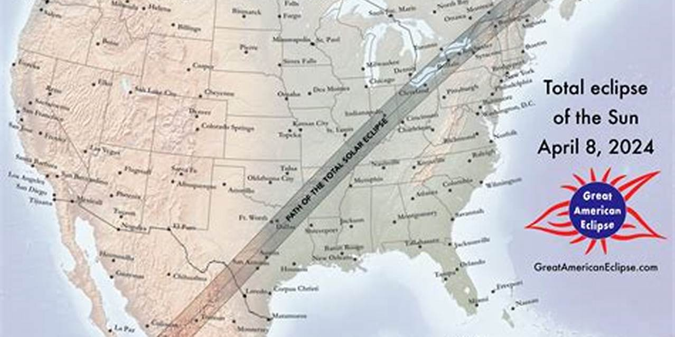
It has been said “that this 2024 one is going to be going through some towns named Nineveh.

Slide 9
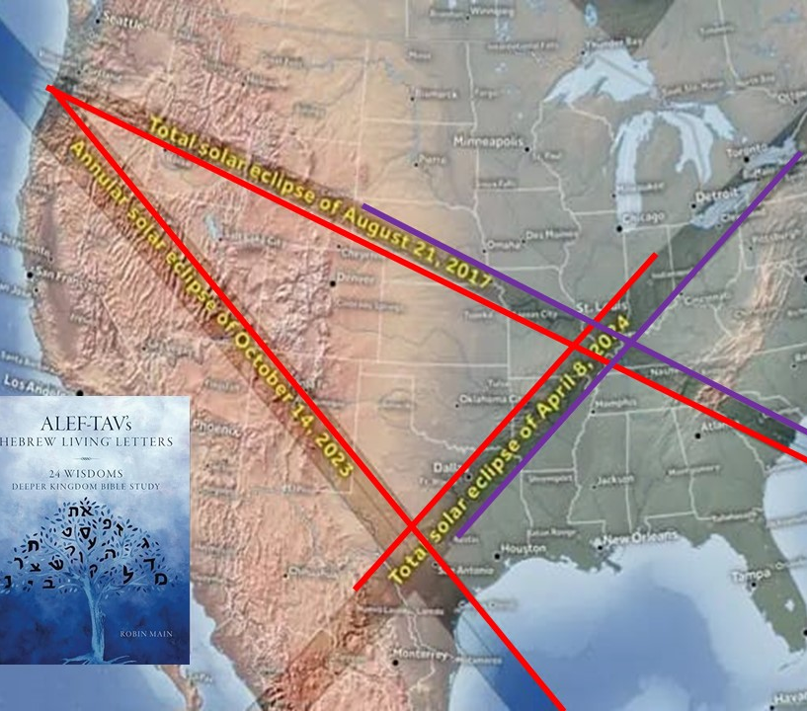
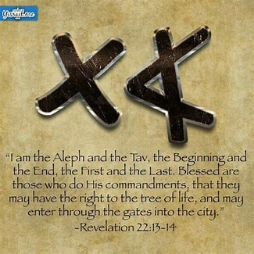
The three ALEF-TAV solar eclipses over the United States, include the first Great American Eclipse on August 21, 2017, the second Great American Eclipse that will happen on April 8, 2024, and the Ring of Fire Eclipse that happened on October 14, 2023.
Jesus is the Aleph (the First) and the Tav (the Last)

Slide 10
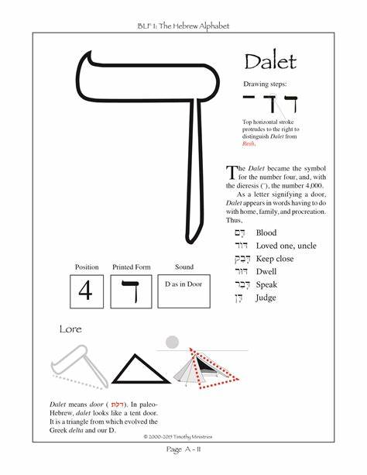
A. Humility - Our April 8, 2024 corresponds with the Hebrew calendar of the 29th of Adar II 5784.
“He (God) mocks proud mockers and shows favor to the humbled and oppressed.”
Proverbs 3:34

Slide 11
B. Doors Opened or Closed
God will close some doors in order to open up others that give a pathway to your eternal destiny

Slide 12
C. Alignment
It will have everything to do with drawing closer to God and having a deep desire to obey His Word

Slide 13
D. Habitation
Jesus left this world to prepare a place for us with Him.
Our temporal bodies are temples of the Holy Spirit who dwells within us.

Slide 14
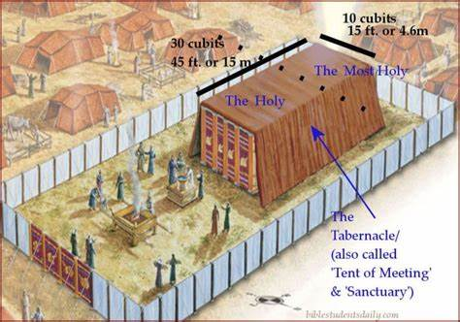
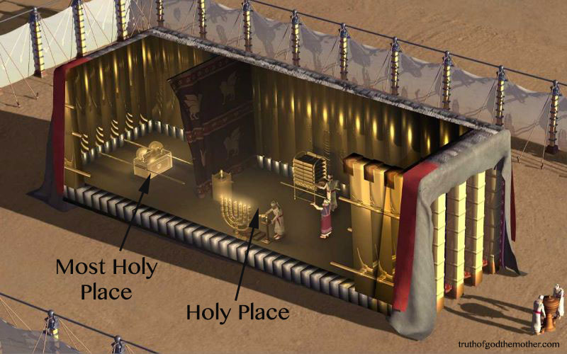
The word used for “Dwelling” means that He “takes up residence” “He tabernacles with us.”
We should ask ourselves what part of the tabernacle depicts our “dwelling place” with God John 1:14

Slide 15
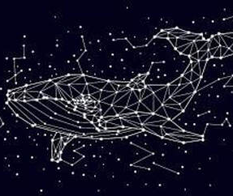
II. THE SIGN OF JONAH
I’ve heard of some that are correlating judgement with the position of the constellation of “Cetus the whale” during this next eclipse

Slide 16
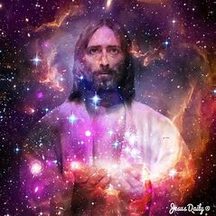
II. THE SIGN OF JONAH

