Slide 1
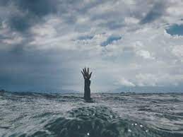
WHEN THE NEEDS NEVER END
Text: Matthew 9:35-38

Slide 2
What Did Jesus Do When He Reached this Point in Ministry?

Slide 3
I. HE SAW THE CROWDS (Matthew 9:36a)
"When he saw the crowds”
Matthew 9:38a
“This gospel of the kingdom will be preached (kerusso) in all the world as a testimony to all nations, and then the end will come."
Matthew 24:14
What Did Jesus Do When He Reached this Point in Ministry?

Slide 4
I. HE SAW THE CROWDS (Matthew 9:36a)
"He said to them, 'Go into all the world and preach (kerusso) the good news to all creation."
Mark 16:15
What Did Jesus Do When He Reached this Point in Ministry?

Slide 5
II. HE HAD COMPASSION ON THEM (Matthew 9:36b)
“When he saw the crowds, he had compassion on them, because they were harassed and helpless, like sheep without a shepherd.”
Matthew 9:36
What Did Jesus Do When He Reached this Point in Ministry?

Slide 6
III. HE CALLED HIS DISCIPLES TO PRAYER (Matthew 9:38)
“Ask (or pray) the Lord of the harvest, therefore, to send out workers into his harvest field.”
Matthew 9:38
What did Jesus Do When He Reached this Point in Ministry?

