Slide 1
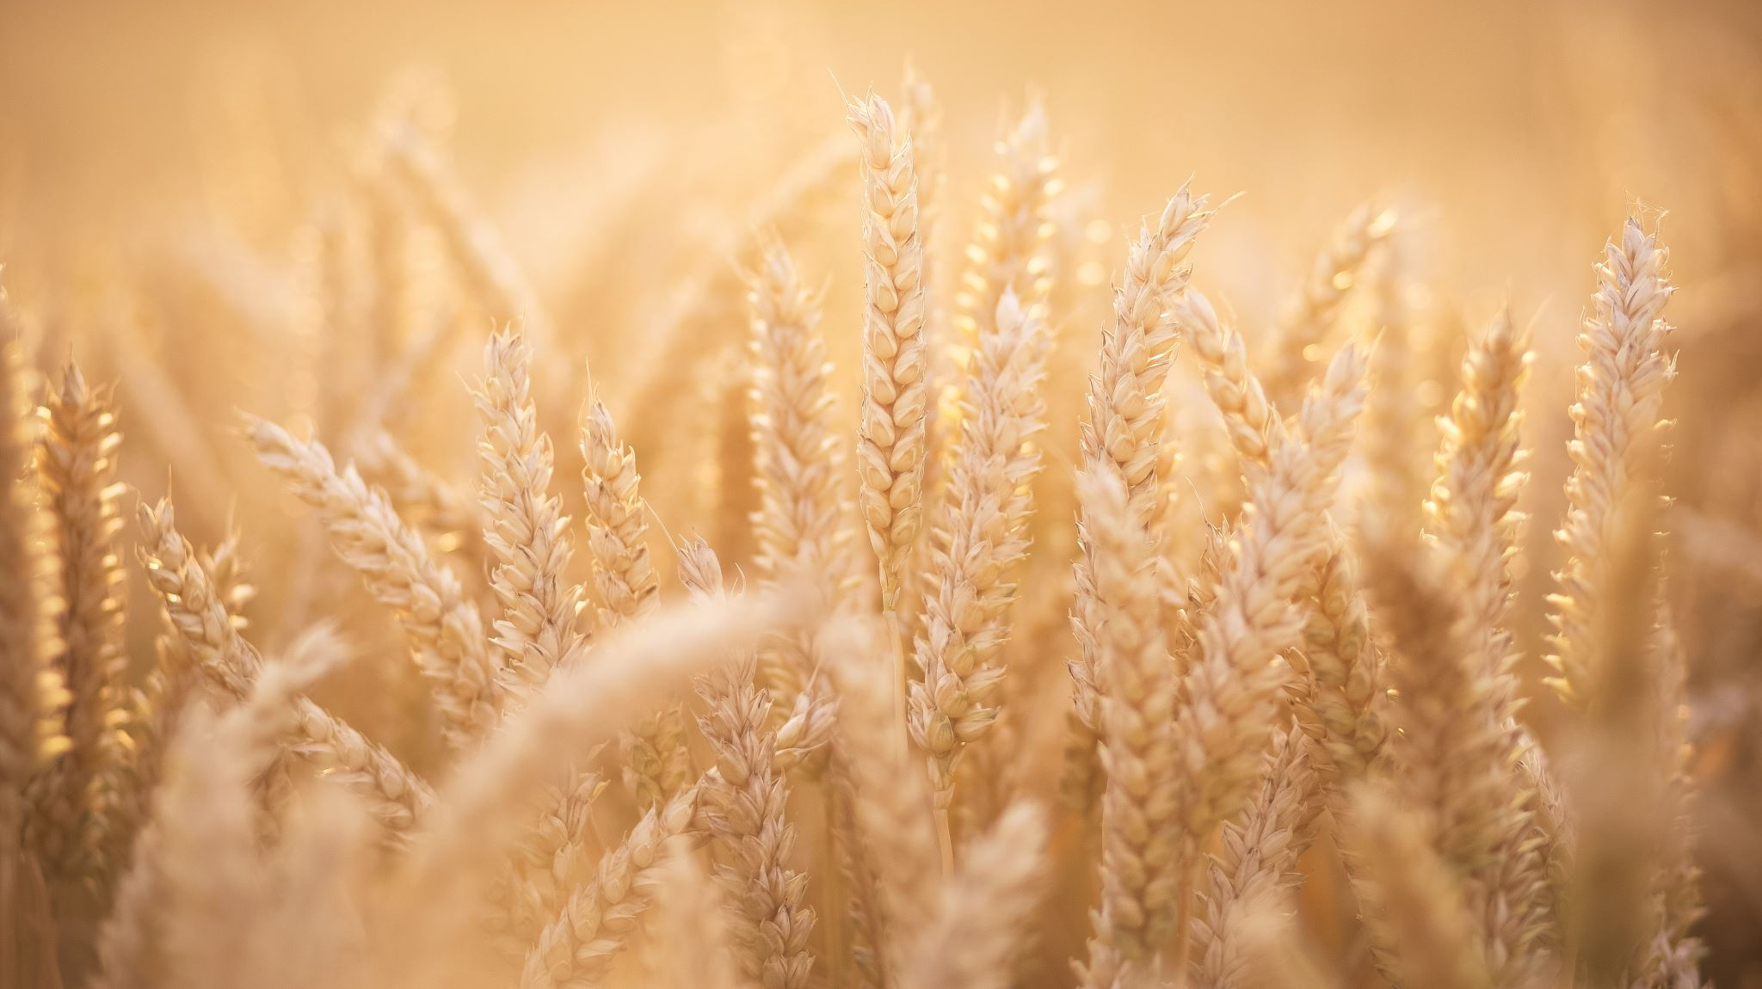
Wheat or tares
MATTHEW 13:24-30

Slide 2
Jesus told them another parable: “The kingdom of heaven is like a man who sowed good seed in his field. But while everyone was sleeping, his enemy came and sowed weeds among the wheat, and went away. When the wheat sprouted and formed heads, then the weeds also appeared.
MATTHEW 13:24-30

Slide 3
“The owner’s servants came to him and said, ‘Sir, didn’t you sow good seed in your field? Where then did the weeds come from?’ “‘An enemy did this,’ he replied. “The servants asked him, ‘Do you want us to go and pull them up?’

Slide 4
“‘No,’ he answered, ‘because while you are pulling the weeds, you may uproot the wheat with them. ³⁰ Let both grow together until the harvest. At that time I will tell the harvesters: First collect the weeds and tie them in bundles to be burned; then gather the wheat and bring it into my barn.’”

Slide 5
THE SEED

Slide 6
2 Corinthians 13:5 (NIV) “Examine yourselves to see whether you are in the faith; test yourselves. Do you not realize that Christ Jesus is in you—unless, of course, you fail the test?” 2 Peter 1:10 (NIV) “Therefore, my brothers and sisters, make every effort to confirm your calling and election. For if you do these things, you will never stumble.”

Slide 7
i. Both were planted together
a) THE CHARACTER OF THE SEED

Slide 8
i. Both were planted together
b) THE CHARACTER OF THE SOWER

Slide 9
ii. Both progressed together
a) THERE WAS ALL THE ACTIVITY OF THE WHEAT

Slide 10
"The person without the Spirit does not accept the things that come from the Spirit of God but considers them foolishness and cannot understand them because they are discerned only through the Spirit." 1 Corinthians 2:14 NIV

Slide 11
ii. Both progressed together
b) THERE WAS ALL THE APPEARANCE
OF WHEAT

Slide 12
ii. Both progressed together
c) THERE WAS NONE OF THE ABUNDANCE
OF WHEAT

Slide 13
“But the fruit of the Spirit is love, joy, peace, forbearance, kindness, goodness, faithfulness, gentleness and self-control. Against such things there is no law.” Galatians 5:22-23 NIV

Slide 14
"But the Lord said to Samuel, “Do not consider his appearance or his height, for I have rejected him. The Lord does not look at the things people look at. People look at the outward appearance, but the Lord looks at the heart.” 1 Samuel 16:7 NIV

Slide 15
III. BOTH WERE PROCESSED TOGETHER
a) THE TARES WERE BURNED

Slide 16
III. BOTH WERE PROCESSED TOGETHER
b) THE WHEAT WAS BARNED

Slide 17
BEWARE…..
1. GOOD WORKS
2. GOOD BELIEFS
3. GOOD PEOPLE
4. GOOD FEELINGS

