Slide 1
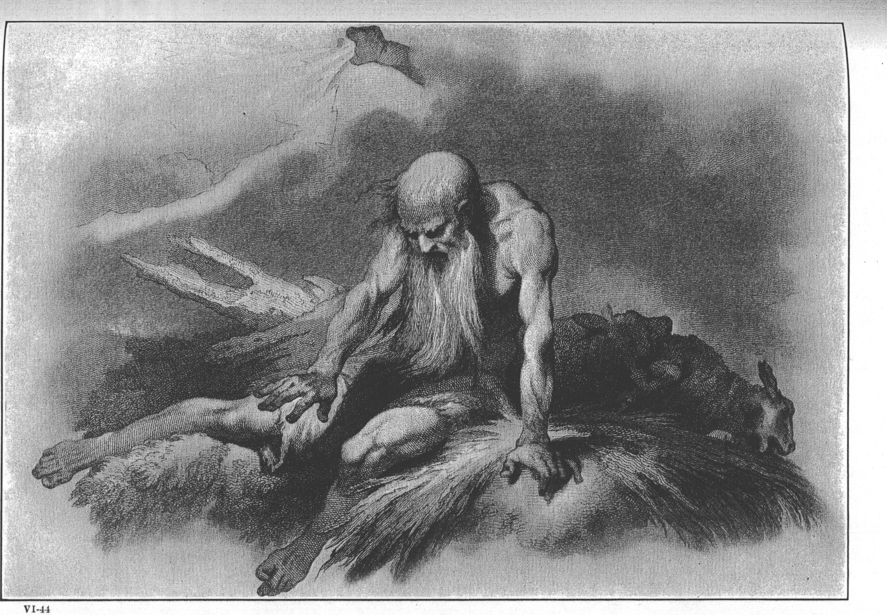
Words from a Deep Grieving Soul - Breaking the Silence
Text: Job 3:1-26

Slide 2
“In the multitude of words sin is not lacking, But he who restrains his lips is wise.” Proverbs 10:19 New King James Version “When there are many words, wrongdoing is unavoidable, But one who restrains his lips is wise.” Proverbs 10:19 New American Standard Bible

Slide 3
I. DID HE CURSE THE DAY OF HIS BIRTH (Job 3:1-10)?
“After this, Job opened his mouth and cursed the day of his birth.”
Job 3:1

Slide 4
I. DID HE CURSE THE DAY OF HIS BIRTH (Job 3:1-10)?
“Let the words of my mouth, and the meditation of my heart, be acceptable in thy sight, O Lord, my strength, and my redeemer.”
Psalm 19:14

Slide 5
I. DID HE CURSE THE DAY OF HIS BIRTH (Job 3:1-10)?
“Set a guard over my mouth, LORD; keep watch over the door of my lips.”
Psalm 141:3

Slide 6
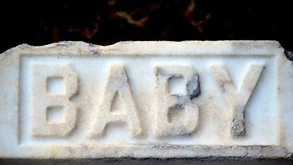
II. DID HE PREFER BEING BURIED LIKE A STILLBIRTH CHILD (Job 3:11-19)?
“Or why was I not hidden away in the ground like a stillborn child, like an infant who never saw the light of day?”
Job 3:16

Slide 7
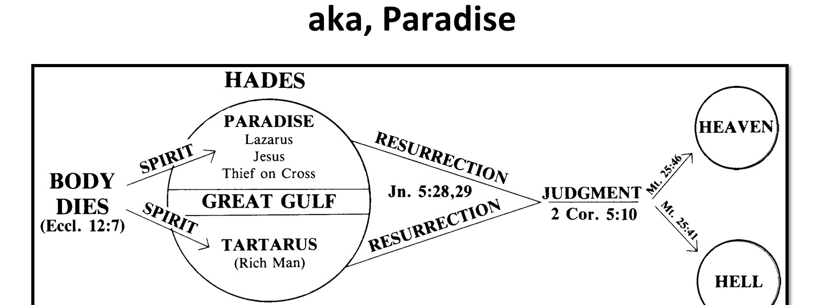
II. DID HE PREFER BEING BURIED LIKE A STILLBIRTH CHILD (Job 3:11-19)?
Job 3:13,17; Luke 16:19-31; Luke 13:22-30;
II Peter 2:4,7-9

Slide 8
III. DID HE PREFER EUTHANASIA OVER LIFE (Job 3:20-23)?
“Even people who want to go to heaven don't want to die to get there.”
Steve Jobs - Cofounder, chairman, and CEO of Apple

Slide 9
III. DID HE PREFER EUTHANASIA OVER LIFE (Job 3:20-23)?
Why is life given to a man whose way is hidden, whom God has hedged in?
Job 3:23

