Slide 1
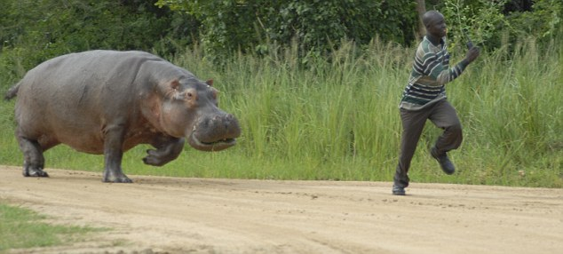
WORST CASE SCENARIOS
JOB 3:25-26

Slide 2
I. THE CHARACTER OF JOB’S LIFE
HE LIVED A GODLY LIFE
HE LIVED A GOOD LIFE
HE LIVED A GRACED LIFE

Slide 3
II. THE CATASTROPHES OF JOB’S LIFE
HIS CATASTROPHES TOUCHED HIS FORTUNE
HIS CATASTROPHES TOUCHED HIS FAMILY
HIS CATASTROPHES TOUCHED HIS FITNESS

Slide 4
III. THE CLASSROOM OF JOB’S LIFE
HE LEARNED LESSONS ABOUT THE PERSON OF GOD
HE LEARNED LESSONS ABOUT THE PURPOSES OF GOD
HE LEARNED LESSONS ABOUT THE POWER OF GOD

Slide 5
IV. THE COMPLETION OF JOB’S LIFE
A TIME OF PERSONAL REPENTENCE
A TIME OF PARTICULAR REVIVAL
A TIME OF POWERFUL RESTORATION
A TIME OF PROFOUND REFLECTION

Slide 6
…IN A VALLEY, COMING OUT OF A VALLEY, OR GOING INTO A VALLEY…..

Slide 7
WHAT WORST CASE SCENARIO CAN YOU IMAGINE?

