Slide 1
YOU ARE ENOUGH
2 KINGS 4:1-7

Slide 2
“The wife of a man from the company of the prophets cried out to Elisha, “Your servant my husband is dead, and you know that he revered the Lord. But now his creditor is coming to take my two boys as his slaves.” Elisha replied to her, “How can I help you? Tell me, what do you have in your house?” “Your servant has nothing there at all,” she said, “Except a small jar of olive oil.” 2 Kings 4:1-7 NIV

Slide 3
Elisha said, “Go around and ask all your neighbors for empty jars. Don’t ask for just a few. Then go inside and shut the door behind you and your sons. Pour oil into all the jars, and as each is filled, put it to one side.” She left him and shut the door behind her and her sons. They brought the jars to her, and she kept pouring. When all the jars were full, she said to her son, “Bring me another one.” 2 Kings 4:1-7 NIV

Slide 4
But he replied, “There is not a jar left.” Then the oil stopped flowing. She went and told the man of God, and he said, “Go, sell the oil, and pay your debts. You and your sons can live on what is left.” 2 Kings 4:1-7 NIV

Slide 5
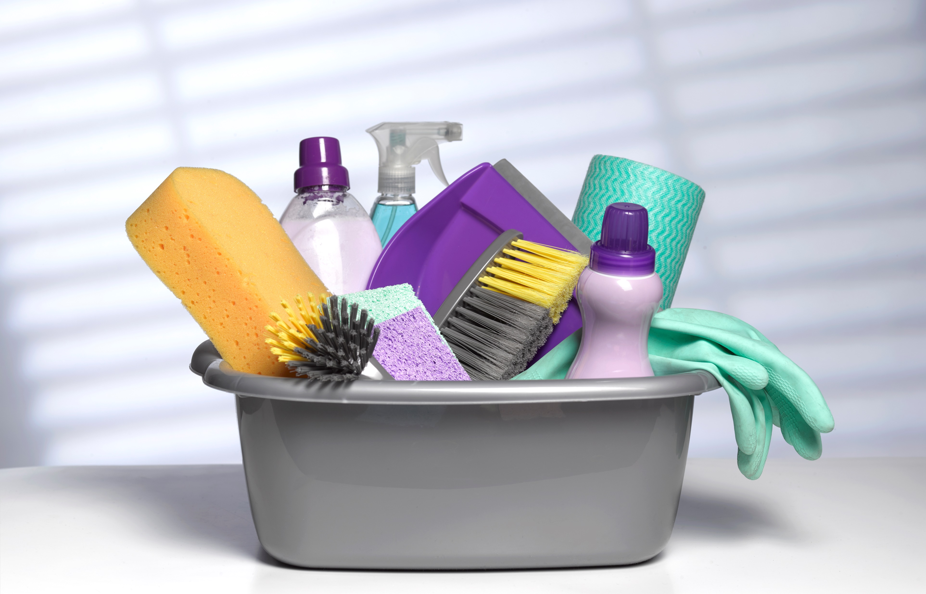
I. GOD CAN USE YOUR TALENTS

Slide 6
II. GOD CAN USE YOUR LOVE

Slide 7
III. GOD CAN USE YOU

Slide 8
“For we are God’s handiwork, created in Christ Jesus to do good works, which God prepared in advance for us to do.” Ephesians 2:10 NIV ***** “In a large house there are articles not only of gold and silver, but also of wood and clay; some are for special purposes and some for common use.” 2 Timothy 2:20

Slide 9
WHATEVER YOU HAVE IS ENOUGH FOR GOD TO USE FOR HIS GOOD PURPOSE

Slide 10
THE SPECIAL DAY….

Slide 11
HAPPY MOTHER’S DAY

