Slide 1
Kingdom Value
Deuteronomy 8:2-9
Humility with obedience and respect brings Kingdom value.

Slide 2
Worldly Value

Slide 3
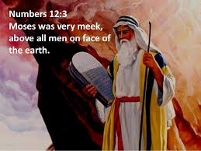

Slide 4
the value of humility
1 Peter 5:6-7
“Humble yourselves, therefore, under God’s mighty hand, that He may lift you up in due time. Cast all your anxiety on Him because He cares for you.”
. God lifts you up.
. God cares and loves you.
. God heals you.
. God provides for you

Slide 5
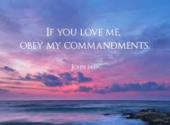
THE VALUE OF OBEDIENCE John 14:15 Samuel 12:24 Proverbs 9:10

Slide 6
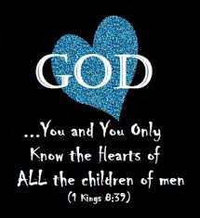
Obedience shows respect to the lord
Moses and the Hebrews learned obedience through discipline
Moses and the Hebrews learned obedience through correction
Moses and the Hebrews learned obedience through value in their hearts
1 Kings 8:39

Slide 7
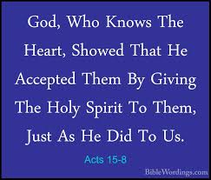
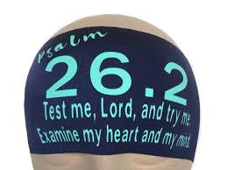
The value of the heart
Acts 15:8
Psalms 26:2

Slide 8
1. Tests the Heart
3. Rewards the Heart
2. Provides for our Hearts
Matthew 6:26
Philippians 4:19
Psalms 147.8

Slide 9
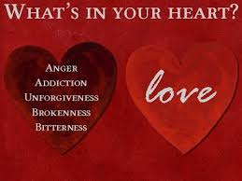

Slide 10
What is the value in your heart ? Is it Kingdom Value ? Humility with obedience and respect in your hearts brings Kingdom Value….

